Slide 1
Provider Webinar
17 March 2023

Slide 2
Contents
Welcome
Grey Cap formulations
1 April eligibility changes
Easter stock orders
Vaccine Safety Surveillance and Research
Vaccinating Health Workers
Questions

Slide 3
Two Pfizer Grey Cap formulations
On 1 March 2023, the Comirnaty (12+ years) purple cap vaccine was retired and replaced with two Comirnaty grey cap formulations for use commencing 1 March 2023.
Comirnaty 30mcg (12+ years) grey cap vaccine for primary doses
Comirnaty Original/Omicron BA. 4/5 (16+ years, if eligible) grey cap vaccine for booster doses
Both grey cap vaccines are prediluted.
All remaining stock of the purple cap vial should now have been disposed of in the Interwaste vial disposal bins and recorded as wastage in the CIR.
Please also ensure you have wasted all expired sodium chloride.
Have you completed and returned your Te Whatu Ora Southern Grey cap preparedness checklist?
Notes:
In August 2022 the Coroner conducted a hearing relating to the death of Rory Nairn. The Coroner has now published her initial findings i.e. that the cause of Rory’s death was myocarditis, due to vaccination with the Comirnaty Pfizer CVOID-19 vaccine. The Coroners inquiry into Rory’s death has not yet concluded – she has yet to establish the circumstances of his death and this information may not be available for some months
However the hearing process did highlight the importance of…

Slide 4
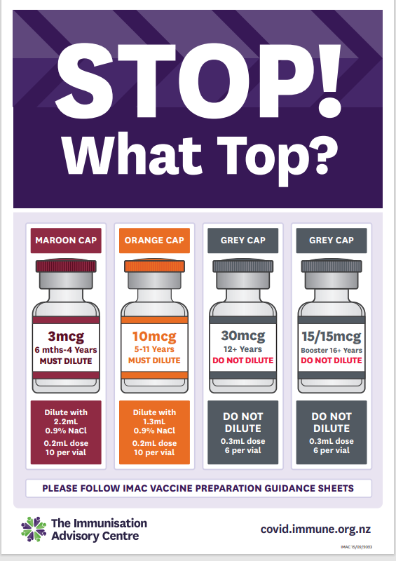
Pfizer formulations guide

Slide 5
What could catch us out
Grey cap vaccines do NOT require dilution. Dilution of a grey cap vial may mean a consumer receives a dose which contains less antigen than the required dose. This is an error and IMAC should be called for clinical advice. Note: Some reassurance to you – it is almost impossible to add saline to a grey cap Comirnaty vial due to the pressure inside.
Comirnaty 30 mcg is intended for primary course only. While a prescription is not required for administering it as a booster dose, the consumer should understand the recommended (first line) booster vaccine in New Zealand is Comirnaty 15/15mcg and the reasons for this. The vaccinator should document this in the notes tab of CIR. This is an error if the consumer has consented for one vaccine and receives a different one and IMAC should be called for clinical advice.
Comirnaty 15/15mcg is only approved for booster use (requires a prescription and written informed consent if being administered as a primary dose). This is an error if it occurs as it is off-label and will need IMAC clinical support as it may mean the consumer has less “original” in their primary course.
Until 1 April 2023, the eligibility criteria for a 2nd booster remains the same. Māori and Pacific peoples aged 40 years and over; all people aged 50 years and over; health, aged care, and disability workers aged 30 years and over.
Those aged 16 and over are eligible for one booster only (unless they have a health condition that puts them at increased risk of COVID-19) or they are within the criteria above

Slide 6
What continues to catch us out
Vaccines given after expiry date
Doses being administered before they are “due” – check timings for primary doses and booster doses, these will not change on 1 March with the grey cap transition
Extra doses being given – never rely on the consumer/admin person. The CIR must be checked – the most frequent error now is an additional second booster being administered
Use of expired saline
Demand for vaccines will rise as winter approaches and vaccinating sites need to review their processes and staffing numbers to avoid risk.

Slide 7
Support and resources
COVID-19 immunisation policy (v4 published March 2023)
Operating Guidelines (v51 published 1 March 2023)
Consent form (updated with clear vaccinator record defining primary and booster doses)
IMAC webinar recorded on Monday 27 February
Comirnaty Grey Cap Factsheet v1 (published 23 February 2023)
Comirnaty Screening Guide (published 1 March 2023)
Comirnaty Grey Cap Quick Reference Guide v1 (published 23 February 2023)
Stop What Top poster for all five Pfizer COVID-19 vaccines (published 15 February 2023)
Comirnaty Expiry poster (published 15 February 2023)
Comirnaty Grey Cap Vaccine Record Sheet
If you have any questions or need assistance, please contact Romilly Smith on romilly.smith@southerndhb.govt.nz or 03 476 9915.

Slide 8
Eligibility changes 1 April 2023
From 1 April 2023, an additional booster dose will be made available to:
anyone aged 30 and over who has completed a primary course, as long as it’s been at least 6 months since their last COVID-19 booster AND at least 6 months since their last positive COVID-19 test.
NOTE THE CHANGE ON 1 APRIL FROM 3 MONTHS POST COVID POSITIVE TEST TO 6 MONTHS POST COVID POSITIVE TEST FOR ALL COVID VACCINATIONS
people aged 16 years to 29 years of age:
who have a medical condition that increases the risk of severe breakthrough COVID-19 illness
who live with disability with significant or complex health needs or multiple comorbidities
Please note link below for clinical criteria for 16 to 29 years additional booster
Clinical criteria in support of second booster eligibility | Ministry of Health NZ

Slide 9
Stock Orders
Introduction of Grey Cap 2 and 5 packs
Label design is going through final consultation
ETA of labels is now the week commencing 20 March
TENTATIVELY, providers will be able to place orders for delivery the week commencing 27 March
Please be extra diligent with inventory updates from 1 April as vaccinating providers will be busier and need to keep on top of stock-on-hand.
Easter Orders
Please ensure you have adequate stock- vaccines and collateral in advance of the Easter break
If your regular delivery days are Friday 7 April; Monday 10 April; Tuesday 11 April there will be no deliveries on these days—ensure you order sufficient stock in advance

Slide 10
Stay informed
A reminder to all site leads to stay up to date with clinical and operational guidance and to pass this on to your team. This includes updates from:
Southern Vaccine Clinic Hub
Medsafe
Immunisation Advisory Centre (IMAC)
Ministry of Health

Slide 11
Questions?

Slide 12
Vaccinating Health Workers

Slide 13
The journey of the Vaccinating Health Worker
Where we began and where we’re going.
June 2021
CVWUS
implementation
July 2022
CVWUS training ceased
August 2022 New entrant pathway VHW Stage 1
April 2023
VHW Stage 2 Preparation of vaccines
June 2022 CVWUS transition to VHW Stage 1
February 2023
VHW Stage 2

Slide 14
VHW Stage 1 Training Pathway
VHW Stage 1
COVID-19 &
Influenza
HPV9 and
Tdap
CIR / AIR
CPR (basic
life support)
Core learning
IMAC
training
Facilitated or provided by employer
Practical Workshop
2 vaccine
Assessment
Authorisation
4 vaccine

Slide 15
VHW Stage 2 Training Pathway
Entry requirements to VHW Stage 2
IMAC training
Authorised in all four vaccines
Complete core learning
VHW Stage 2
Tamariki and MMR
Administer at least 25 vaccinations over at least 8 weeks
Employer registers VHW for Stage 2
Practical Workshop
Assessment
Authorisation
VHW Stage 2 Preparation Pathway
Second checker
Preparation workbook
Assessment
Authorisation

Slide 16
Employers of VHW
Service delivery
Staff profile matches needs of the community
Quality
Ensure access to the core learning for the VHW
Ensure clinical supervisors have training and knowledge of the VHW role
Ensure VHW attends and completes training
Retain accurate training records of VHW
Ensure VHW are included in handovers and clinical updates to keep their vaccination knowledge current
Safety
Ensure appropriately trained and certified staff work under supervision of a registered health professional
Ensure that all VHW and VHW clinical supervisors have
indemnity insurance

Slide 17
Clinical Supervisors of VHWs
Role:
Provide direction and guidance to VHW
Must be onsite, within constant ear shot/easy calling distance for assistance
Work within their scope of practice
Adhere to terms of employment contract and policies and procedures
Resources available for supervisors:
VHW Supervisors Information sheet
‘Course for Supervisors of
Vaccinating Health Workers’
VHW Capability Matrix
Nursing Council’s Guideline: Delegation of care by a registered nurse to a health care assistant

Slide 18
Vaccinating Health Worker
1
Total possible candidates
517 current CVWUS
251 new entrant pathway for VHW
Implementation report – 6 March 2023
474 have enrolled in Supervisor training,
of which 263 have completed
Achievements in the past week:
43 people have registered in the VHW Stage 1 new entrant pathway.
29 people have enrolled in COVID-19 and Influenza training, 37 have enrolled in HPV9 and Tdap training and 50 have enrolled in Supervisor training.
2
Enrolled in Stage 1 vaccine theory training
242 enrolled* in Influenza 12+
191 enrolled in COVID-19 and Influenza 12+
3
Completed Stage 1 theory training
216 completed Influenza 12+
163 completed COVID-19 and Influenza 12+
Planning:
Final review is underway for the Webpage information and will be uploaded in the near future. We are aligning this with opening the access of Stage One online training.
The Stage two administration course is now live on the IMAC website.
Pipeline:
242 have enrolled in the Influenza course of which 216 have
completed the training. These numbers wont change
251 have enrolled in the VHW Stage 1 course of which 215 have completed.
191 have enrolled in the COVID-19 and Influenza 12+ of which 163 have completed the theory.
208 people have enrolled in the HPV9 and Tdap training of
which 176 have completed.
98 people have been authorised as Stage 1 VHW of which 23 have completed the requirements for all four vaccines.
The chart below illustrates where candidates currently are on the VHW authorisation pipeline, by phase and percentage.
* Culminated totals are used in
this figure
4
Practical training and assessment phase
281 undertaking practical training and assessments
5
Authorised for Stage 1
98 authorised
Demographic of Stage 1 authorised VHW
Ethnicity
District
Unknown
1
Māori
Waitematā
5
Pacific
Waikato
2
13
Other
Tairāwhiti
7
15
South Canterbury
7
23%
12%
46%
46%
Nelson Marlborough
1
Training phase (enrolled in training)
Lakes
3
4
1
Practical assessment phase (completed theory training)
Authorised for Stage 1
Counties Manukau
2
16
65%
8%
Canterbury/West Coast
2
2
Auckland
13

Slide 19
Provisional Vaccinator Bridging
Provisional Vaccinator Pathway is closed
Provisional Vaccination Authorisation is for 2 years and not renewable
Due to reissuing Provisional Vaccinator Authorisations to those who were authorised prior to July 21, update training is required and available – contact vaccinatorauthorisations@health.govt.nz
Bridging available to those who meet the requirements to become a Fully
Authorised Vaccinator or Pharmacist Vaccinator
Bridging Training is free until 30 April
Access is via the new IMAC LMS
https://www.immune.org.nz/education/overview
785 have enrolled and 558 have completed the training

Slide 20
Vaccine Safety Surveillance and Research: Active monitoring for Influenza and COVID-19 vaccines
Lewis Forsyth, Advisor
Vaccine Safety Surveillance & Research (VSSR), National Immunisation Programme (NIP), National Public Health Service (NPHS)

Slide 21
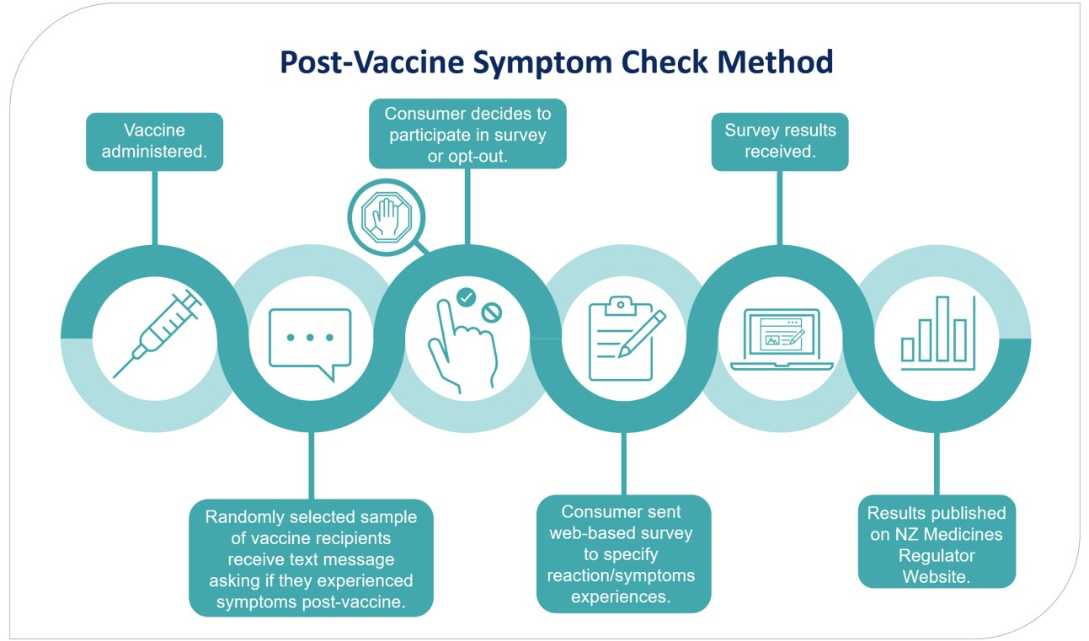
Post Vaccine Symptom Check (PVSC) 2021/22: Pfizer COVID-19 Vaccine
Active monitoring through national survey
COVID Immunisation Register (CIR) used to identify participants
Addresses issues of underreporting through the
spontaneous reporting system
Provides timely data, AEFI denominator and individual impact of AEFI e.g., attendance at work/school
Provides platform for consumers to voice vaccine experience
PVSC survey data published on the Medsafe website
Output is easy to understand and can address
vaccine safety concerns
Helps maintain public confidence and trust in the programme

Slide 22
2023 PVSC Campaigns: Influenza & COVID-19 Bivalent Vaccine
COVID-19 bivalent vaccine campaign:
CIR used to identify participants
Influenza PVSC campaign: Opt in approach
QR codes at vaccination sites
Possibility to use AIR in the future
Refer page 12 Flu Toolkit 2023. QR codes available to print from Nat Imms Programme Dropbox
Survey data will be published on a publicly
available website e.g., Medsafe/MOH
Vaccinators/HCPs can share this data to reassure patients
Future PVSC: possibility of broadening the tool to include other vaccines/medicines and increase reach and accessibility e.g., via email, phone, mail
Surveys are sent via
SMS 7 and 42 days after vaccination

Slide 23
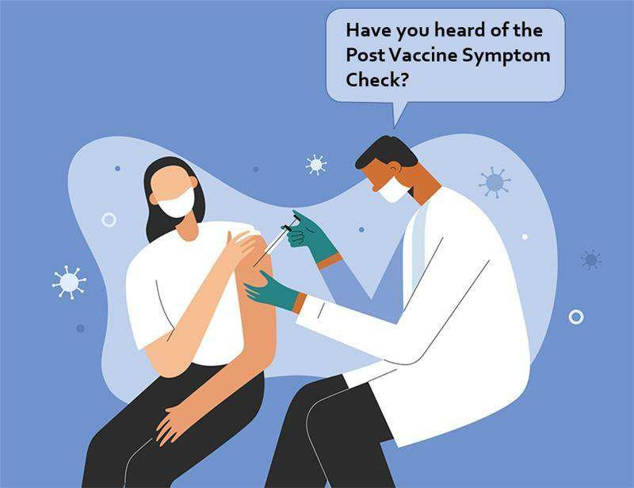
PVSC Awareness
Important that consumers are informed of PVSC during the vaccination process
Scan QR codes
SMS contact
Important for all participants to respond, even those that did NOT experience an adverse event following immunisation
Increased participation is best for everyone!

