Slide 1
Provider Webinar
22 September 2022

Slide 2
Contents
Welcome
Initial learnings from coroner’s inquest
Informed Consent
Myocarditis and pericarditis
Programme update
Importance of recording COVID-19 vaccine consumption
Boosters: local and national data, messaging and resources
Community activity
MMR data
AIR
Questions

Slide 3
Initial learnings from the coroner’s inquiry into the death of Rory Nairn
Have comprehensive processes in place to support vaccinating staff to remain up-to date with vaccination information processes
Utilise only the most up-to-date consumer collateral/resources. Processes should be in place to discard any out-of-date resources
Informed consent prior to any vaccination event must include communicating information about potential serious side effects/adverse events even if they are rare
Consumers should always be provided with both verbal and written information on post vaccination aftercare, including key signs and symptoms of concern and what to do if these occur
Notes:
In August 2022 the Coroner conducted a hearing relating to the death of Rory Nairn. The Coroner has now published her initial findings i.e. that the cause of Rory’s death was myocarditis, due to vaccination with the Comirnaty Pfizer CVOID-19 vaccine. The Coroners inquiry into Rory’s death has not yet concluded – she has yet to establish the circumstances of his death and this information may not be available for some months
However the hearing process did highlight the importance of…

Slide 4
Informed consent
Before anything is administered, it is important to gain informed consent.
This must include clear explanation of possible side effects, including rare but serious ones.
A known rare but serious side effect is myocarditis and pericarditis.

Slide 5
Myocarditis and pericarditis
Myocarditis and pericarditis have been established as very rare but serious adverse events associated with the Pfizer and Novavax vaccine
People with these conditions are usually diagnosed, investigated and managed effectively
Importance of timely assessment and management to prevent the serious consequences of myocarditis and pericarditis

Slide 6
Myocarditis and pericarditis
Data on clinically-validated myocarditis and pericarditis in the 30 days following the vaccine shows:
Globally, the rate appears to be highest in younger men (aged 18-24 years) and after the second dose
Myocarditis occurred mostly within 4 days but in a few cases up to 14 days after vaccination
The most common symptomatology described is:
chest heaviness, discomfort, tightness or pain
Difficulty breathing, shortness of breath
feeling dizzy, light-headed or faint
racing or fluttering heart, or a feeling of skipped beats
The onset of these symptoms was usually in the first few days following the vaccine but can occur in the weeks after

Slide 7
Myocarditis and pericarditis
Serious complications of this condition are avoidable with timely assessment and treatment
A critical component to preventing the harm of vaccine-associated myocarditis/pericarditis is effective person-centred communication at the point of vaccination.
Informing consumers of the rare and serious potential side-effects (such as anaphylaxis, myocarditis and pericarditis) is crucial
The few people who will be affected by vaccine-associated myocarditis/pericarditis must know what symptoms they might experience, and when and how to seek medical advice in time to prevent harm
This is important information also for those who present with parents and caregivers.

Slide 8
Programme update
Aging in: From today children receive the age-appropriate COVID-19 vaccine primary dose. If they have turned 12 since their first dose, they will now receive an adult second dose. An 8-week gap is recommended between the paediatric and adult doses. In CIR, the adult dose of the Pfizer BioNTech vaccine must be selected for the second dose using ‘Different Vaccine Administered’ and the batch number must be entered correctly.
Novavax: From today, Novavax is approved for those aged 12+ for primary course. Boosters are still only available to 18+
Stock expiry: There have been a number of expiries recently of vaccine and saline. Please make sure you have not only wasted stock in the portal and also physically disposed of this expired stock accordingly.
Labour Day 24th October: no deliveries on Monday 24th or Tuesday 25th
so if you have deliveries scheduled for those days ensure you have ordered
enough stock the week before to tide you over.

Slide 9
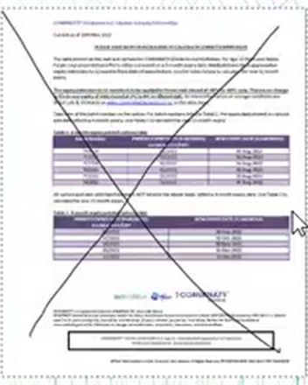
Importance of recording COVID-19 vaccine consumption
Consumption of vaccines and consumables is required to:
Provide local, regional and national view of stock on hand
Locate stock in the event of a recall or batch trace
Quarantine Stock
Recording of consumption can be done two ways:
Entered directly when consumed
Accounted for as part of daily stock take
Destroy old expiry/new expiry date info sheets that look like this:

Slide 10
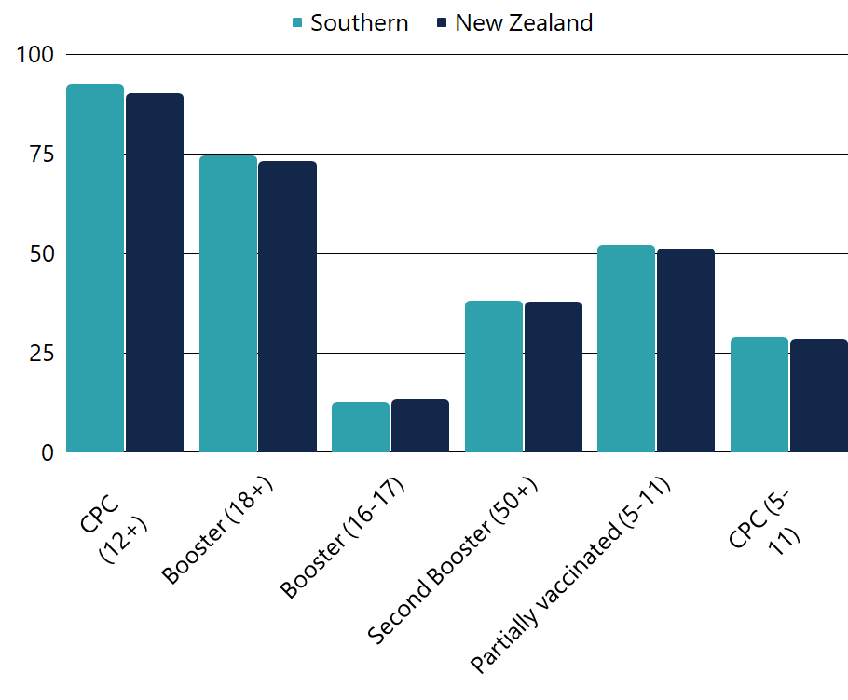
Local and National COVID-19 vaccination rates
All Ethnicities
 | CPC (12+) | Booster (18+) | Booster (16-17) | 2nd Booster (50+) | Partially vaccinated (5-11) | CPC (5-11)
Southern | 92.6% | 74.6% | 12.6% | 37.9% | 52.1% | 28.8%
NZ | 90.2% | 73.2% | 13.3% | 37.7% | 51.1% | 28.5%
National Reporting Data as of 20 September 2022, using the 2021 Health Service User dataset.*
*From 8 August, Te Whatu Ora - Health New Zealand started using the updated HSU 2021 dataset to calculate COVID-19 coverage.
The 2021 HSU dataset contains approximately 233,000 more people than the 2020 dataset – a 4.7 percent increase. As such, rates of vaccination are lower but it is important to remember that this does not change the overall number of -vaccinations delivered.
Notes:
Data shows that we are in line with, or slightly above, national vaccination rates for all age groups and doses except boosters for 16-17-year-olds.

Slide 11
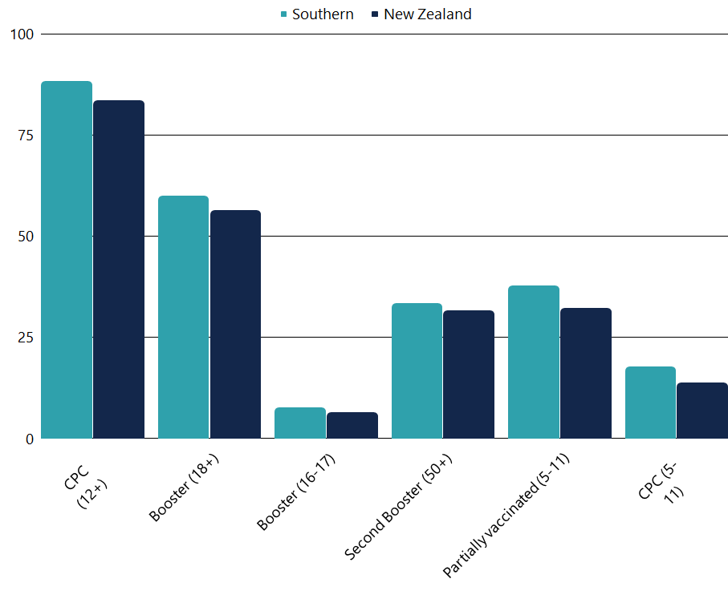
Local and National COVID-19 vaccination rates
Māori
 | CPC (12+) | Booster (18+) | Booster (16-17) | 2nd Booster (50+) | Partially vaccinated (5-11) | CPC (5-11)
Southern | 88.4% | 60% | 7.7% | 33.4% | 37.7% | 17.8%
NZ | 83.6% | 56.3% | 6.5% | 31.7% | 32.3% | 13.7%
National Reporting Data as of 19 September 2022, using the 2021 Health Service User dataset.
Notes:
For Māori, we remain above national vaccination rates for all ages and doses.

Slide 12
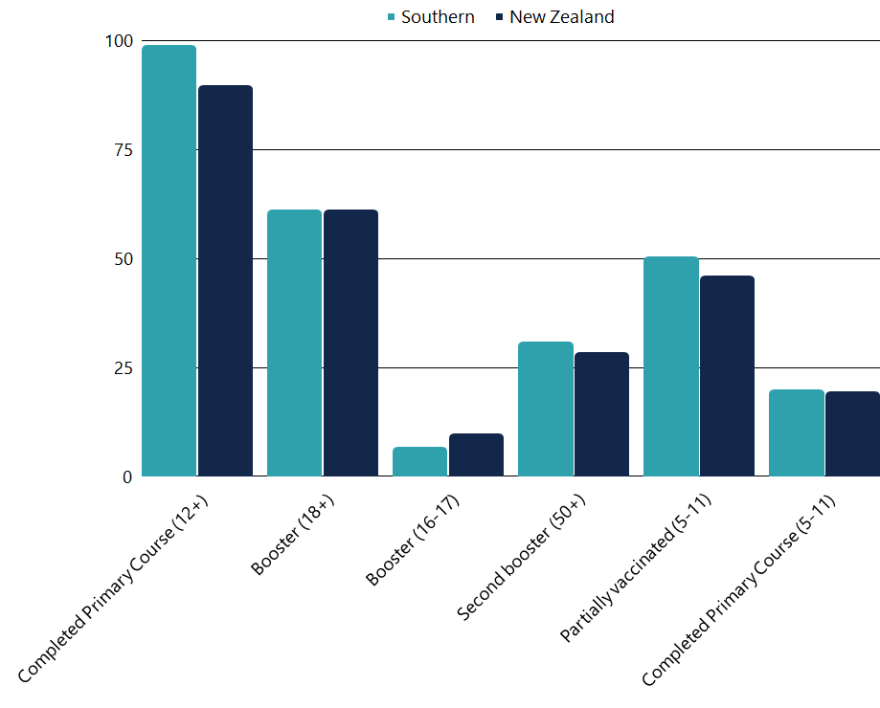
Local and National COVID-19 vaccination rates
Pasifika
 | CPC (12+) | Booster (18+) | Booster (16-17) | 2nd Booster (50+) | Partially vaccinated (5-11) | CPC (5-11)
Southern | >99% | 61.2% | 6.7% | 30.9% | 50.5% | 19.9%
NZ | 89.7% | 61.1% | 9.7% | 28.4% | 46% | 19.4%
National Reporting Data as of 19 September 2022,
using the 2021 Health Service User dataset.
Notes:
Pasifika data, like our overall data, shows that there is more work to be done in the 16-17-year-old boosters cohort to meet national vaccination rates.

Slide 13
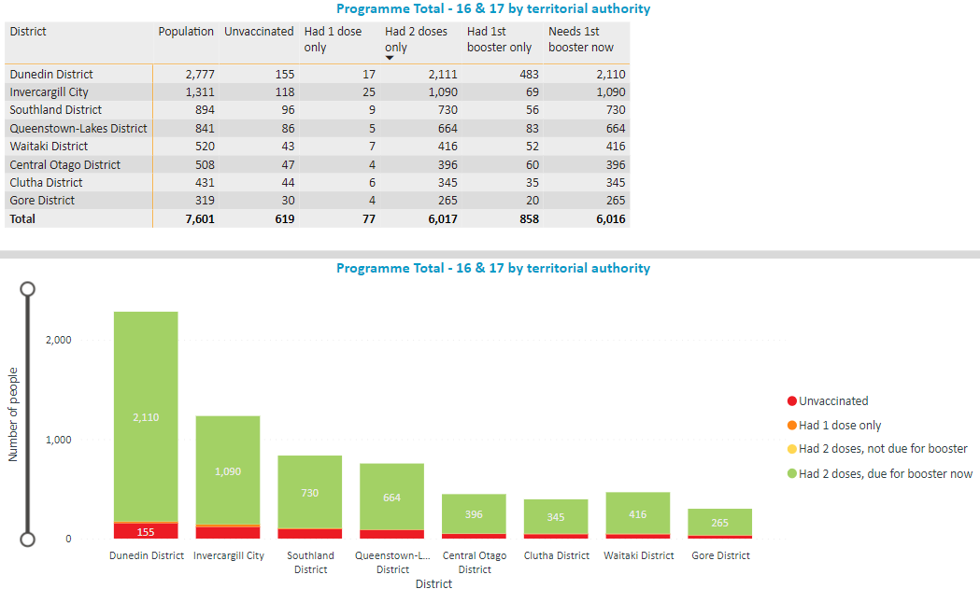
Southern data: 16-17 COVID-19 vaccinations

Slide 14
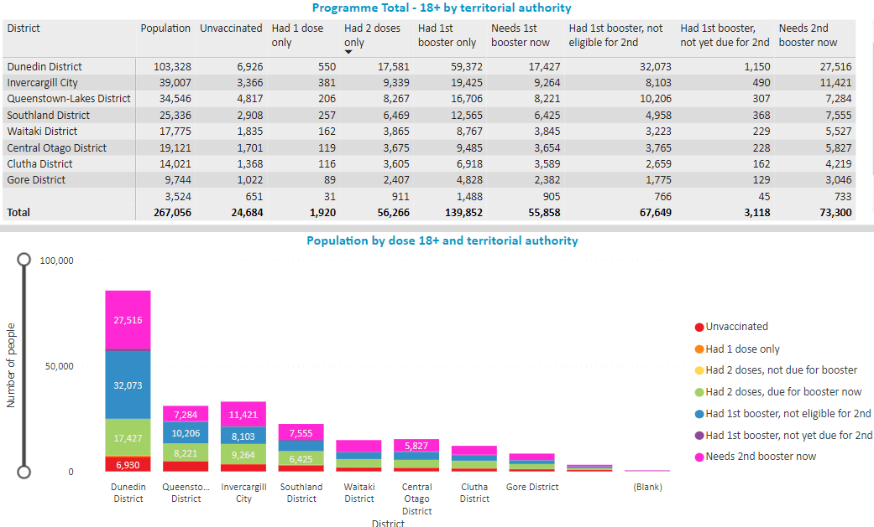
Southern data: 18+ COVID-19 vaccinations

Slide 15
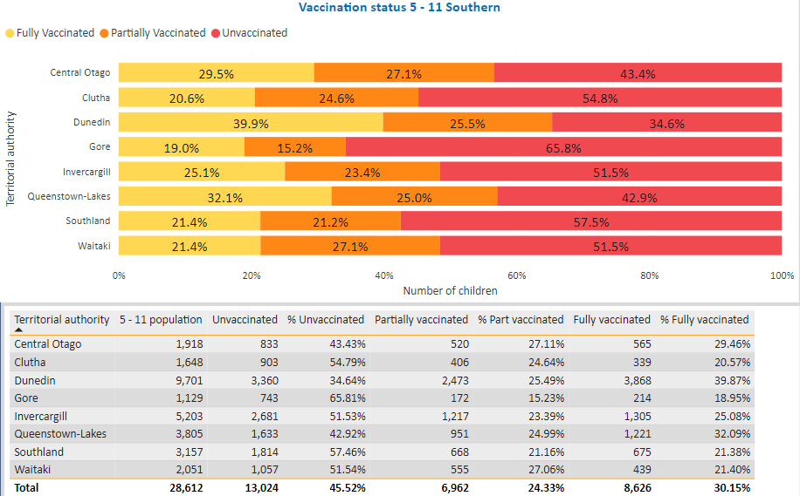
Southern data: 5-11yrs COVID-19 vaccinations

Slide 16
Eligibility and intent
Data from the Ministry of Health commissioned Boosters in the Current Context - August 2022
First booster
Second booster
76% of those eligible know they are eligible
78% of those eligible know they are eligible
Hesitant
26%
Definitely or likely to get a booster
44%
Hesitant
56%
Definitely or likely to get a second booster
74%
Notes:
This is taken from an ad hoc survey commissioned by the MoH looking at public perceptions of boosters. Encouragingly it shows that the majority of those eligible for a further dose know they are eligible. Applying this to our own data, we can expect a further 24,578 in Southern to get their booster, and an additional 56,549 people to get a second booster.
Those who have had one booster are more likely to get a second (if eligible) than those who have completed a primary course are to get a booster. First boosters remain our biggest challenge.

Slide 17
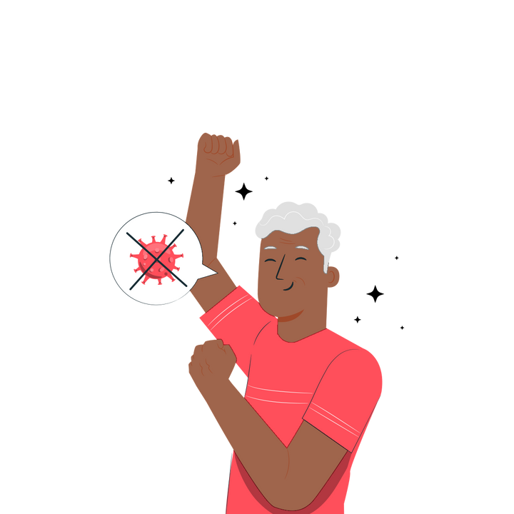
How to reach people eligible for COVID-19 vaccination
Data shows a lot of latent intent (people who intend to be vaccinated but are not acting). We need to make it as easy as possible for these people, including:
Opportunistic vaccinations
Walk-in opportunities
Collaborating with community leaders and events
Combat misinformation, particularly around side effects and efficacy
New resources are coming to support you in talking to the community
The MoH is looking to provide clearer efficacy data on boosters, and length of immunity
A key motivation for people is to get vaccinated to protect the health system from being overwhelmed
Use language such as "up to date with your vaccinations" instead of boosters - some people find the term boosters confusing.
Notes:
We acknowledge that low demand and volumes have been challenging.
The data from the MoH report shows that there are many people with the intent to get their next vaccination, but are not motivated to do it now so we need to continue making this as easy as possible for them.
We continue to see misinformation circling and a shift in motivations now that so much of the population has had COVID-19.

Slide 18
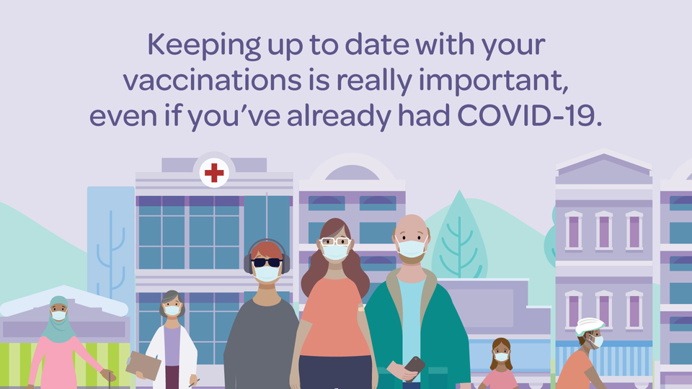
Five important reasons to get your
COVID-19 booster
MoH campaign for August 2022 - updated resources featuring these messages have been added to the Dropbox.
Your immunity from COVID-19 reduces over time so keeping up-to-date with your boosters provides an extra layer of protection.
Boosters help protect you from getting very sick from COVID-19, ending up in hospital, and even death.
Boosters can provide stronger immunity than the natural immunity you get after having COVID-19.
Boosters help you stay well so you can continue to work, travel and spend time with friends and whānau.
The more of us who stay well, the less disruption on our communities, businesses and our health sector.
Notes:
Following their research into public sentiment around boosters, the Ministry of Health has developed a new campaign including five important reasons to get your booster.
You will find a range of resources from this campaign in the NIP dropbox. An interactive tool to help users identify if they are eligible for a dose has been developed and will soon be available to embed on websites.

Slide 19
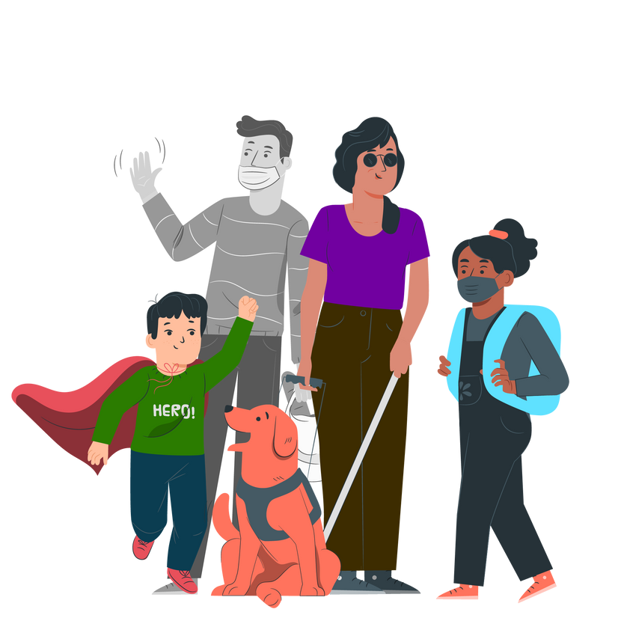
Community activity
People report a lot of trust in community leaders. Are there local networks you can partner with to arrange pop-ups or have a presence at local events?
School holidays 1-16 October - are there opportunities for whānau-centred vaccination events to boost paediatric vaccination rates?
The Te Whatu Ora Southern outreach team are available to support local vaccination events. e.g. Balclutha clinic
Spring Fling - the programme is building a spring/summer tour of the region targeting areas with lower vaccination rates. We will be reaching out to local providers as we plan this.

Slide 20
MMR Vaccinations
In July 2022, Unicef, WHO and IMAC raised the alarm regarding a drop in childhood immunisations during the COVID-19 pandemic.
Internationally 25 million children have missed out on life-saving vaccinations and here in New Zealand Aotearoa we are seeing a similarly concerning trend
.

Slide 21
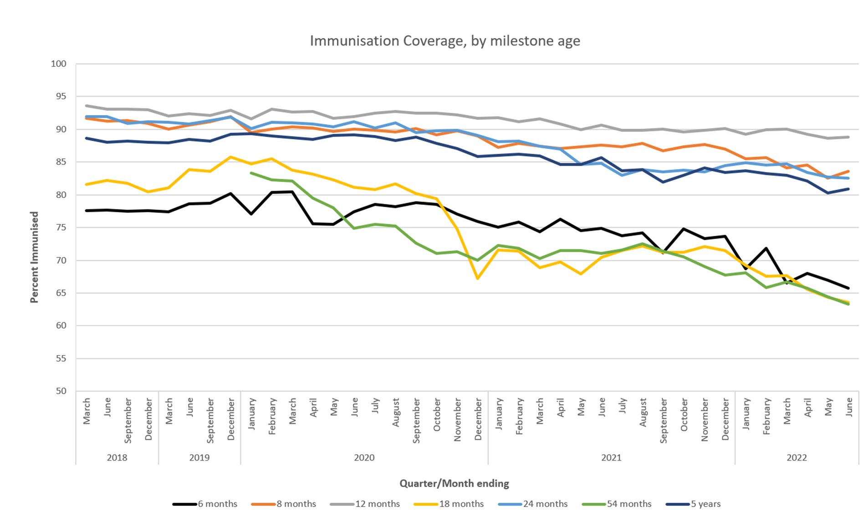
Data from QLIK Te Whatu Ora
Notes:
This graph shows how much childhood immunisations have dropped by. As you can see, vaccinations at ages 6 months, 18 months and 2 years have dropped significantly.

Slide 22
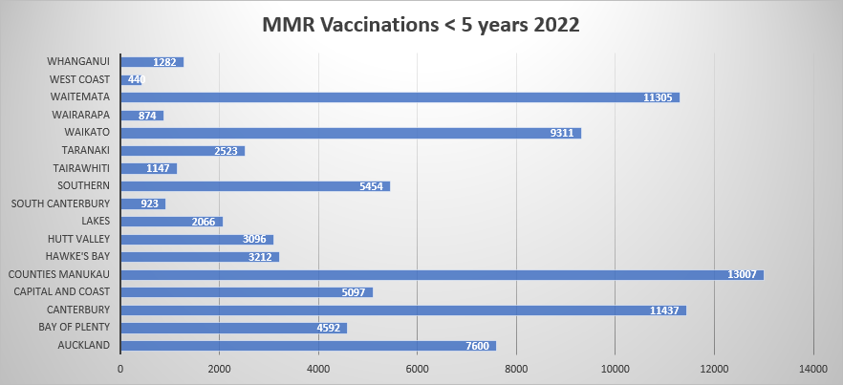
MMR Vaccinations for <5 by DHB
Data from QLIK Te Whatu Ora, 21 September 2022

Slide 23
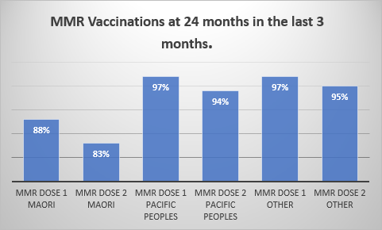
MMR Vaccinations delivered to children at
24 months by dose/ethnicity
Southern data from QLIK Te Whatu Ora, 21 September 2022

Slide 24
Why offer MMR vaccinations to adults?
Increase in reported measles cases internationally. 79% increase Jan / Feb 2022 compared with Jan / Feb 2021
New Zealand's borders are now open
Low update of MMR in the 1990’s following the Wakefield Report – incorrectly linking MMR to autism
Efficacy of earlier vaccinations (70’s and 80’s). Different schedules, and cold chain improvements over the years.
Equity for Māori and Pasifika

Slide 25
MMR vaccination barriers and opportunities
Barriers
Opportunities
Under 5’s – 2nd dose catch up following schedule change.
COVID – Winter Flu’s - access to GP
2nd dose schedule change from 4 years to 15 months
Vaccination weary population
Adult population have no digital record of MMR vaccinations and many are unsure of their MMR vaccination status.
Offer MMR to everyone who may not have had 2 doses in their lifetime - there is no harm in an additional dose if you cannot find any record of their two doses.
Work with Māori and Pasifika communities and providers
Support for pharmacies – pharmacists can give MMR to those over 3 years.
Primary Care – Share the modelling of successful campaigns in primary care.

Slide 26
Aotearoa Immunisation Register (AIR)
New portal to support Vaccinators to record vaccinations and view vaccination history currently existing in the National Immunisation Register (NIR) and the COVID Immunisation Register (CIR).
late-September: pilot for certain providers
mid-October: AIR’s vaccinator portal will be available for Pharmacy to adopt (excluding COVID and Flu which CIR will continue to be used for in the interim)
mid-November: the ImmuniseNow portal will be closing
mid-December: AIR’s vaccinator portal will be able to record additional vaccines, supporting other vaccinators to adopt

Slide 27
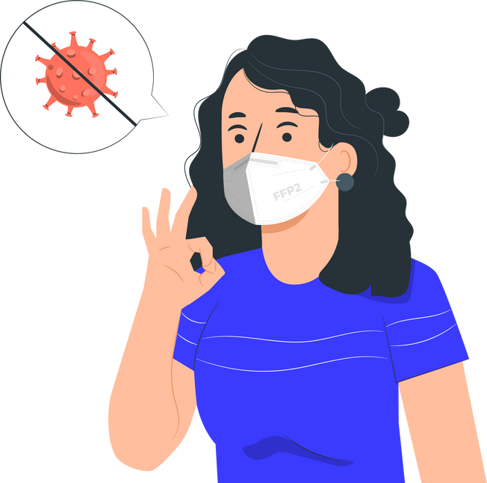
Aotearoa Immunisation Register (AIR)
No changes for GPs at this stage
Providers currently using electronic systems that are connected to the NIR (e.g., PMS in Primary Care) will not be impacted and will continue to record immunisations through their own systems.
Work continues with health software vendors to develop the new AIR integrations.
Specific information on how to adopt will be distributed from mid-September.
In the meantime, please send any questions to
AIR.engagement@health.govt.nz

Slide 28
Stay informed
A reminder to all site leads to stay up to date with clinical and operational guidance and to pass this on to your team. This includes updates from:
Southern Vaccine Clinic Hub
Medsafe
Immunisation Advisory Centre
Ministry of Health

Slide 29
Questions?

