Slide 1
Provider webinar November 2021
Second booster forecasting Covid-19 vaccination 17 June 2022

Slide 2
COVID-19 second booster
Six month interval from first booster
Proposed eligibility includes
People aged 65+
Māori and Pacific peoples aged 50+
Residents of aged care and disability care facilities
Severely immunocompromised people
New: Additional proposed eligibility cohorts (details to follow)
New legislation expected to be in effect from end-June, with second booster announced in the next few weeks
In the meantime, if clinical circumstances warrant, people can access a 2nd booster ‘off-label’ provided consent is obtained, and an authorised prescriber is willing to prescribe it.
Notes:
Emma to present

Slide 3
COVID-19 second booster forecasting
The following slide set represents the new proposed cohorts for second booster, including:
People aged 65+
Māori and Pacific peoples aged 50+
Residents of aged care and disability care facilities
Severely immunocompromised people
New: Additional proposed eligibility cohorts (details to follow)
Notes:
Emma to present

Slide 4
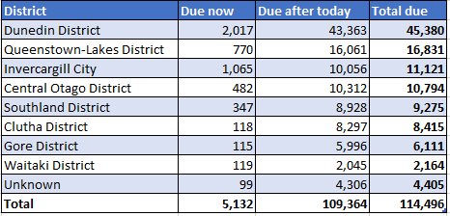
COVID-19 second booster expanded
eligibility – by TA
MoH has yet to announce eligibility criteria. Numbers are estimations of second booster eligibility only.
People who have not received a first booster are not represented in this forecast demand.
Covid infection rates will flatten 2nd booster demand, it is difficult to predict this accurately due to under-reporting of infections
Notes:
MoH has yet to announce eligibility criteria for the 2nd booster.

Slide 5
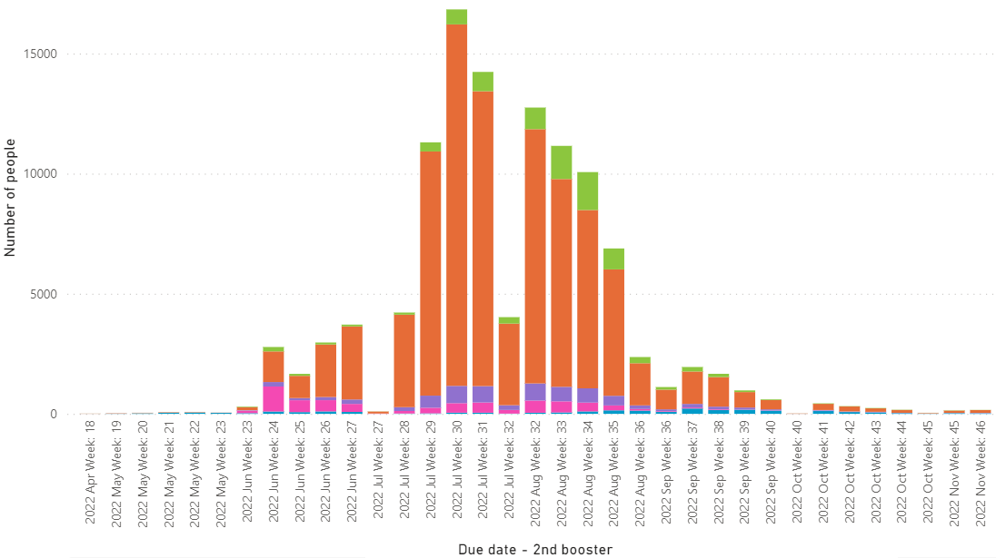
COVID-19 second booster expanded forecast - Southern
Notes:
People who have not received a first booster are not represented in this forecast demand

Slide 6
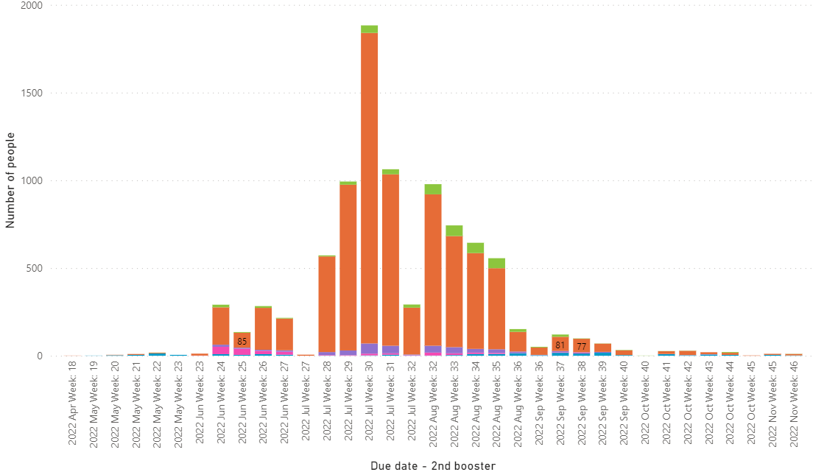
Second booster – Central Otago expanded forecast
Notes:
The MoH has yet to announce eligibility criteria for the 2nd booster.
This data shows demand based on an assumption that groups 1 (border workers) and 2 (health worker) may be eligible (green).

Slide 7
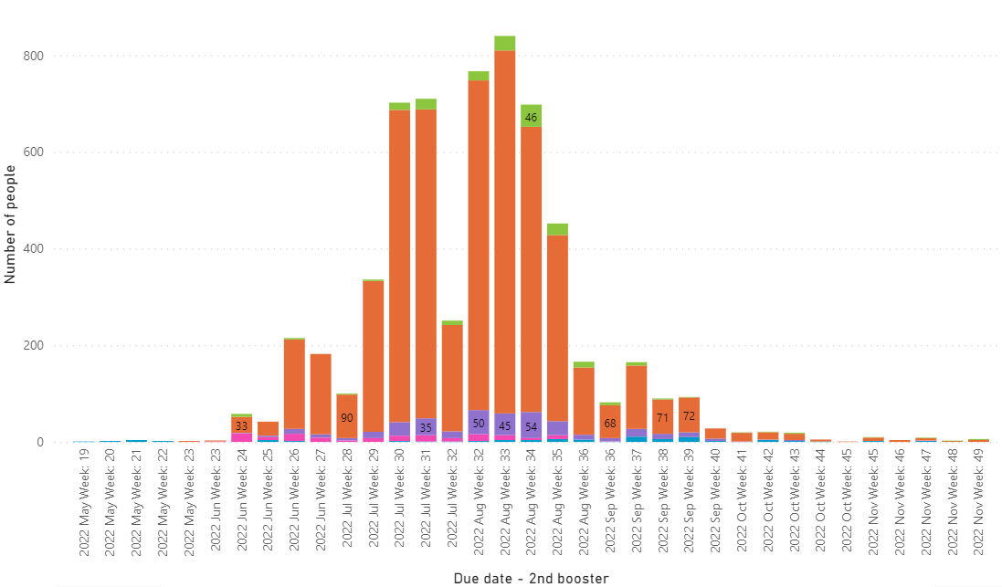
Second booster – Clutha expanded forecast
Notes:
The MoH has yet to announce eligibility criteria for the 2nd booster.
This data shows demand based on an assumption that groups 1 (border workers) and 2 (health worker) may be eligible (green).

Slide 8
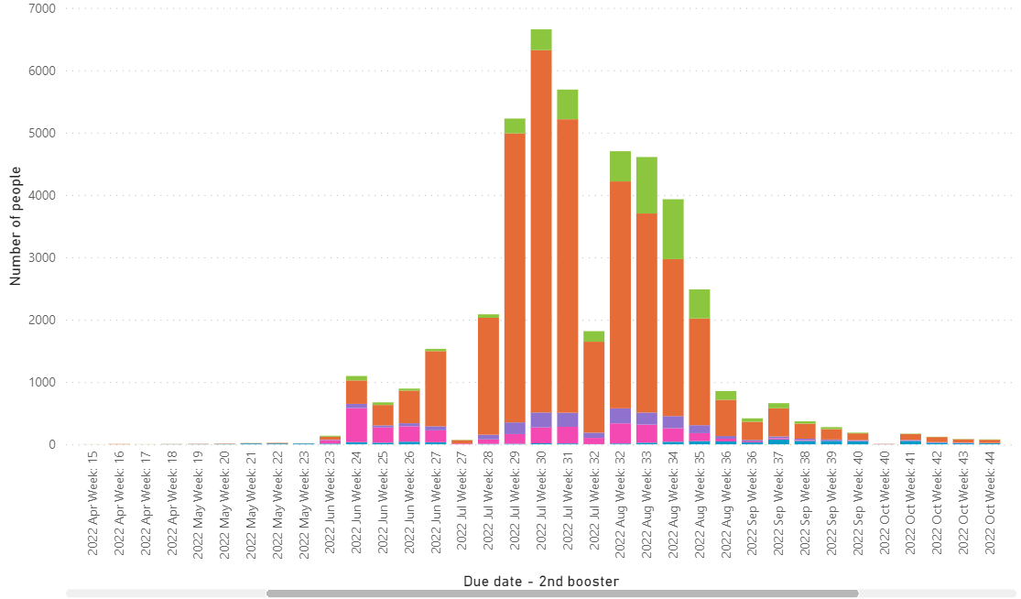
Second booster – Dunedin expanded forecast
Notes:
The MoH has yet to announce eligibility criteria for the 2nd booster.
This data shows demand based on an assumption that groups 1 (border workers) and 2 (health worker) may be eligible (green).

Slide 9
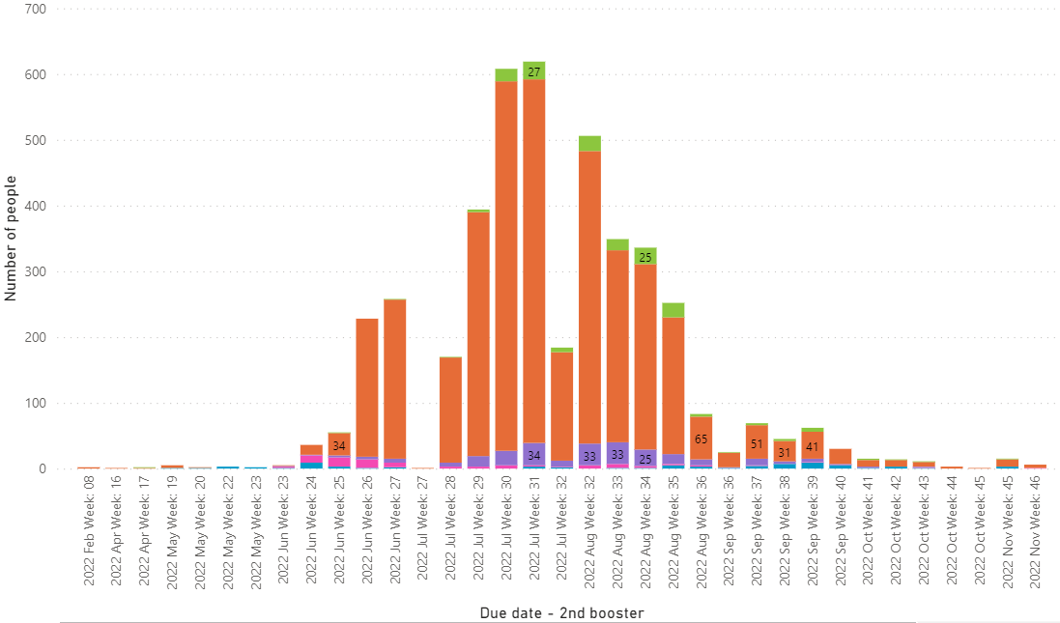
Second booster – Gore expanded forecast
Notes:
The MoH has yet to announce eligibility criteria for the 2nd booster.
This data shows demand based on an assumption that groups 1 (border workers) and 2 (health worker) may be eligible (green).

Slide 10
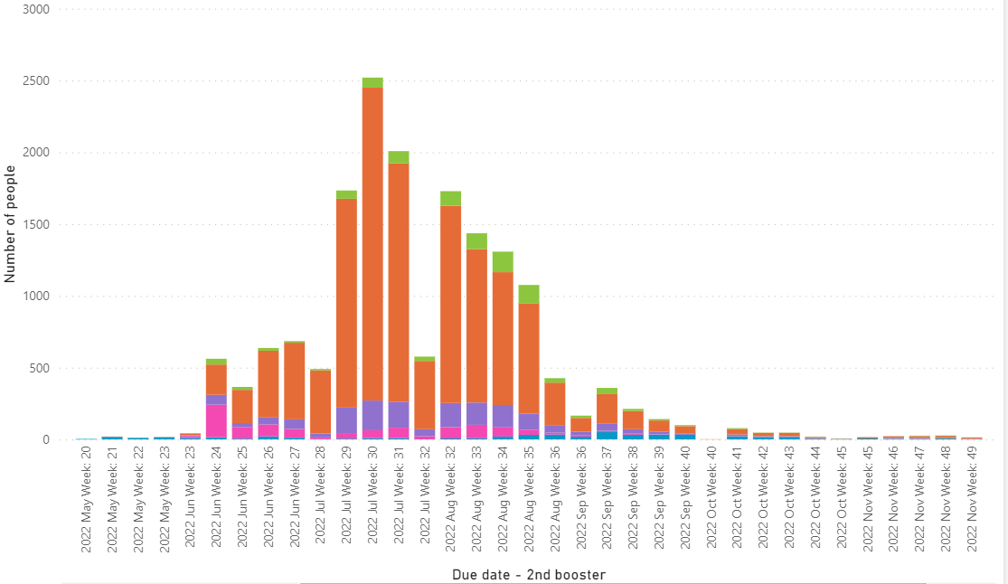
Second booster – Invercargill expanded forecast
Notes:
The MoH has yet to announce eligibility criteria for the 2nd booster.
This data shows demand based on an assumption that groups 1 (border workers) and 2 (health worker) may be eligible (green).

Slide 11
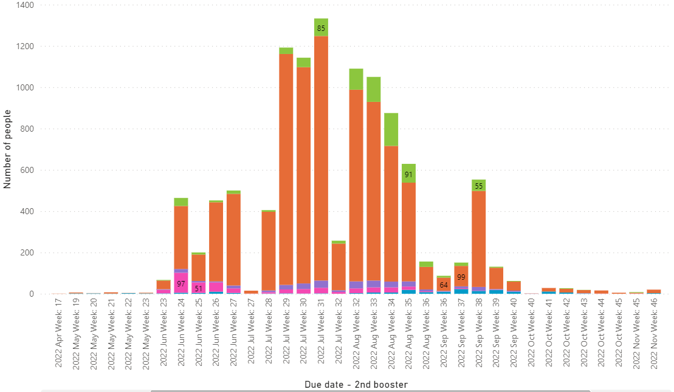
Second booster – Q’town Lakes expanded forecast
Notes:
The MoH has yet to announce eligibility criteria for the 2nd booster.
This data shows demand based on an assumption that groups 1 (border workers) and 2 (health worker) may be eligible (green).

Slide 12
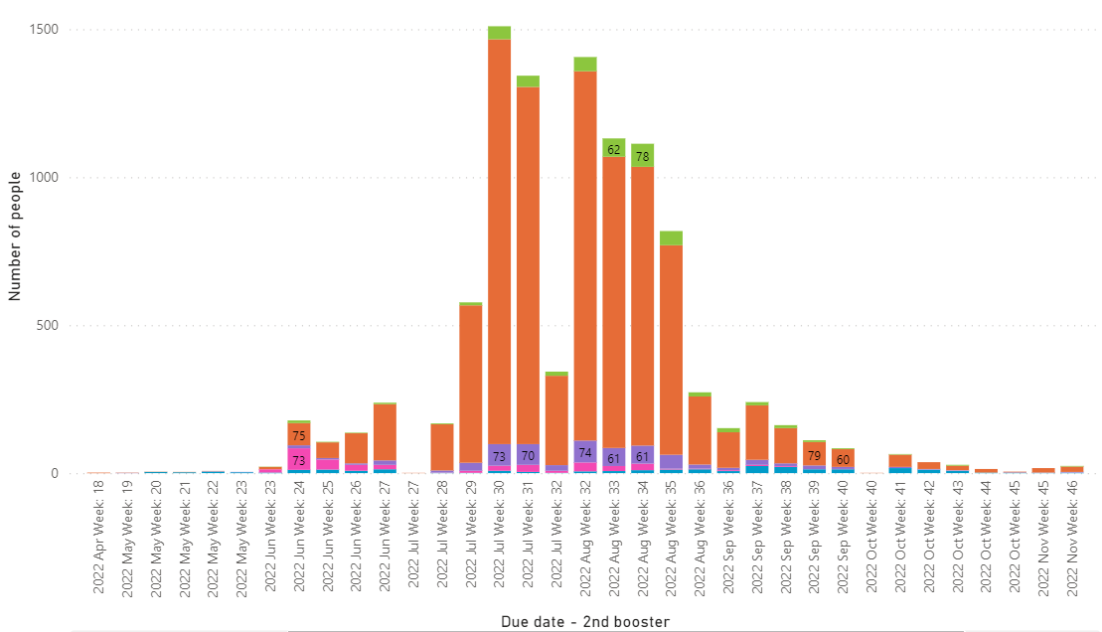
Second booster – Southland expanded forecast
Notes:
The MoH has yet to announce eligibility criteria for the 2nd booster.
This data shows demand based on an assumption that groups 1 (border workers) and 2 (health worker) may be eligible (green).

Slide 13
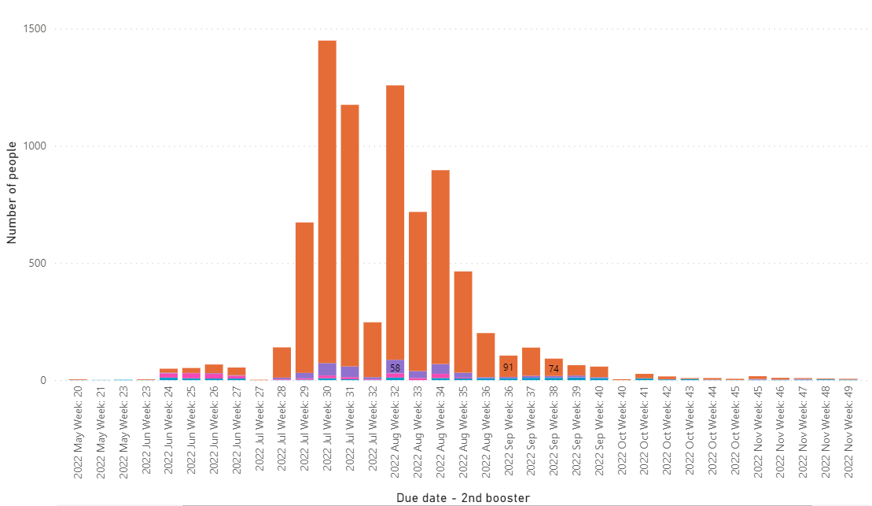
Second booster – Waitaki expanded forecast
Notes:
The MoH has yet to announce eligibility criteria for the 2nd booster.
This data shows demand based on an assumption that groups 1 (border workers) and 2 (health worker) may be eligible (green).

Slide 14
COVID-19 second booster forecasting
For your reference and comparison, the following slide set represents the original proposed cohorts for second booster, including:
People aged 65+
Māori and Pacific peoples aged 50+
Residents of aged care and disability care facilities
Severely immunocompromised people
Notes:
Emma to present

Slide 15
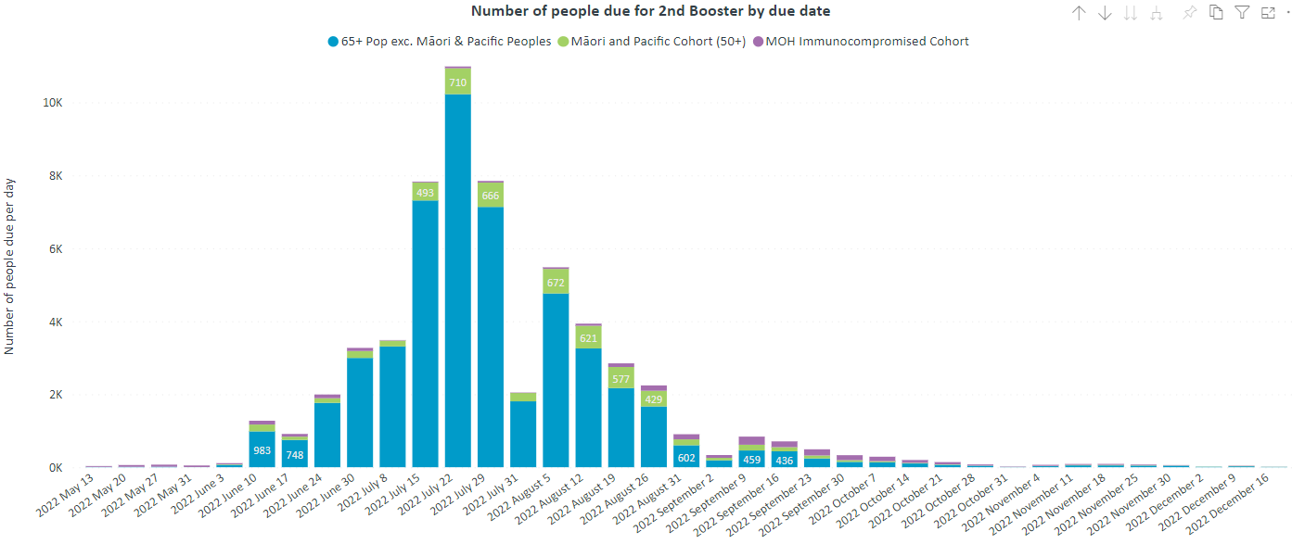
Second booster original forecast - Southern
Notes:
The MoH has yet to announce eligibility criteria for the 2nd booster.
This data shows demand based on an assumption that groups 1 (border workers) and 2 (health worker) may be eligible (green).

Slide 16
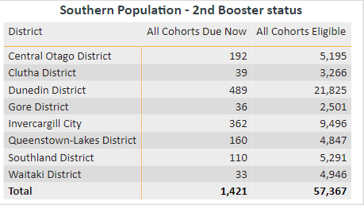
COVID-19 original second booster eligibility
– by TA
Covid infection rates will flatten 2nd booster demand, it is difficult to predict this accurately due to under-reporting of infections
Notes:
MoH has yet to announce eligibility criteria for the 2nd booster. This data shows potential demand if cohorts are eligible.

Slide 17
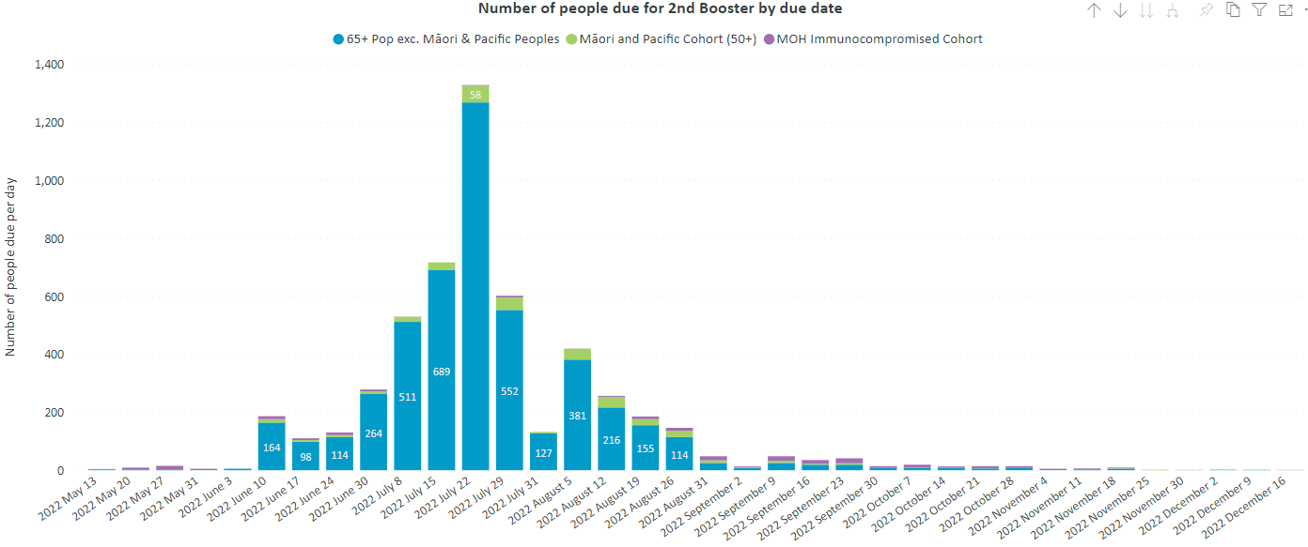
Second booster – original Central Otago forecast
Notes:
The MoH has yet to announce eligibility criteria for the 2nd booster.
This data shows demand based on an assumption that groups 1 (border workers) and 2 (health worker) may be eligible (green).

Slide 18
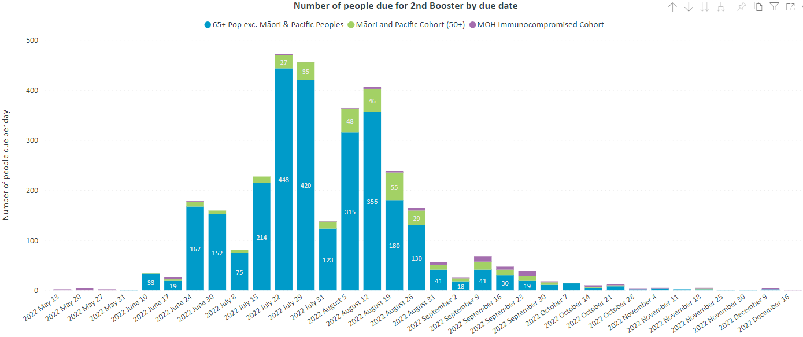
Second booster – original Clutha forecast
Notes:
The MoH has yet to announce eligibility criteria for the 2nd booster.
This data shows demand based on an assumption that groups 1 (border workers) and 2 (health worker) may be eligible (green).

Slide 19
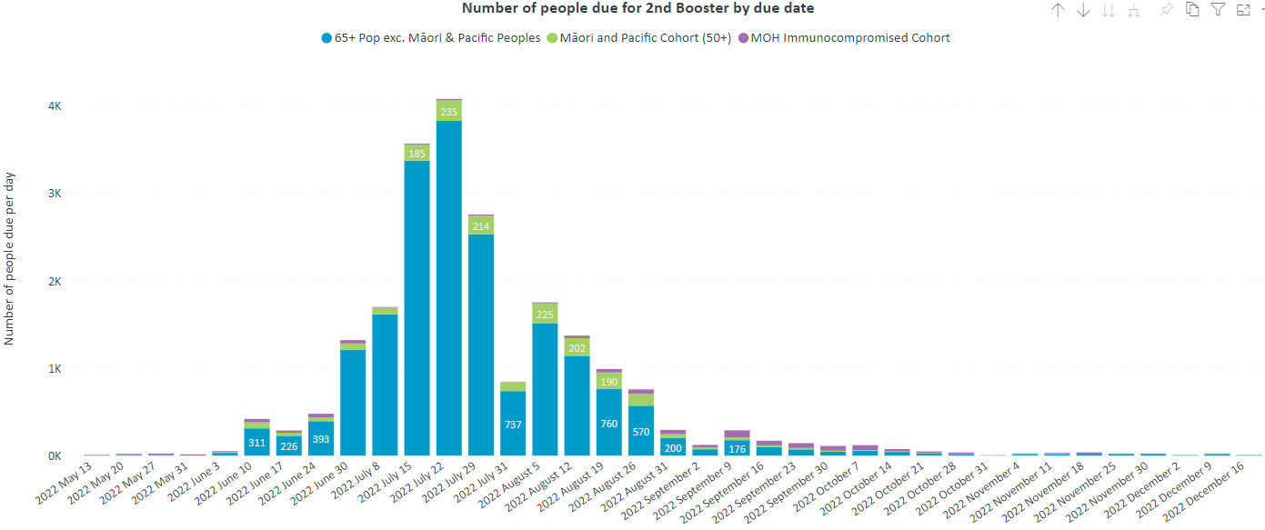
Second booster – original Dunedin forecast
Notes:
The MoH has yet to announce eligibility criteria for the 2nd booster.
This data shows demand based on an assumption that groups 1 (border workers) and 2 (health worker) may be eligible (green).

Slide 20
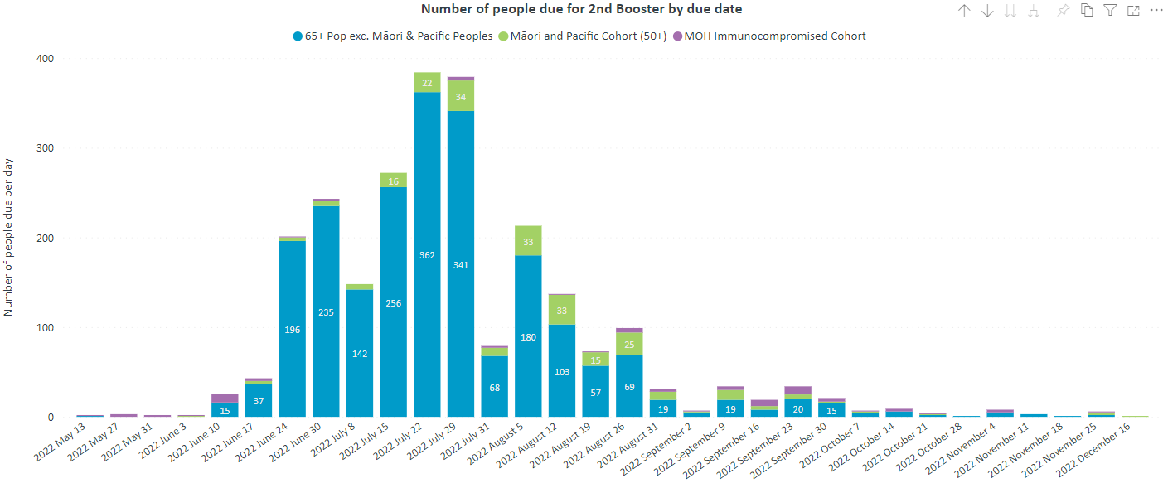
Second booster – original Gore forecast
Notes:
The MoH has yet to announce eligibility criteria for the 2nd booster.
This data shows demand based on an assumption that groups 1 (border workers) and 2 (health worker) may be eligible (green).

Slide 21
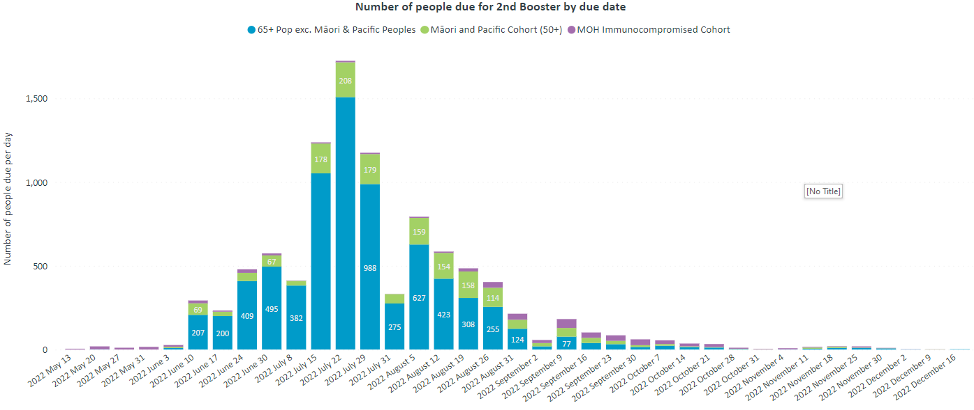
Second booster – original Invercargill forecast
Notes:
The MoH has yet to announce eligibility criteria for the 2nd booster.
This data shows demand based on an assumption that groups 1 (border workers) and 2 (health worker) may be eligible (green).

Slide 22
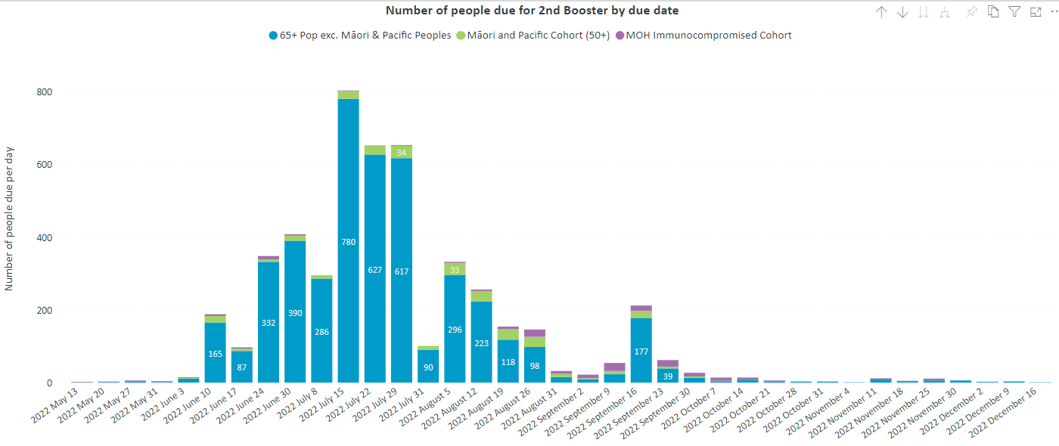
Second booster – original Q’town Lakes forecast
Notes:
The MoH has yet to announce eligibility criteria for the 2nd booster.
This data shows demand based on an assumption that groups 1 (border workers) and 2 (health worker) may be eligible (green).

Slide 23
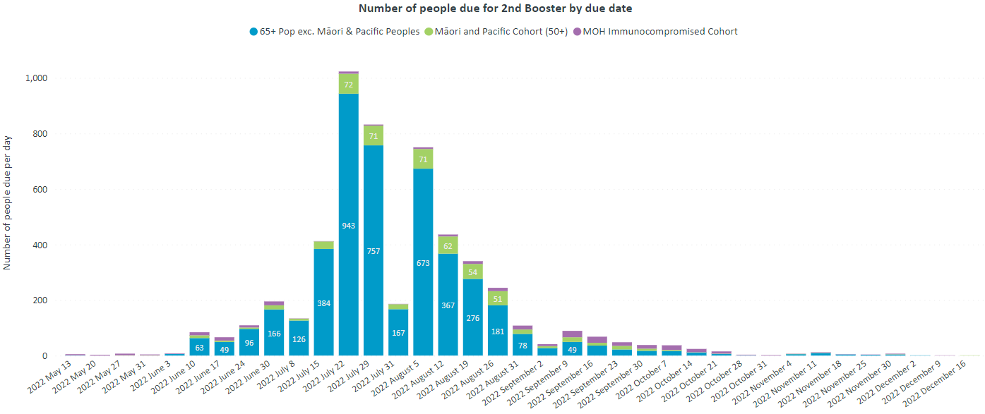
Second booster – original Southland forecast
Notes:
The MoH has yet to announce eligibility criteria for the 2nd booster.
This data shows demand based on an assumption that groups 1 (border workers) and 2 (health worker) may be eligible (green).

Slide 24
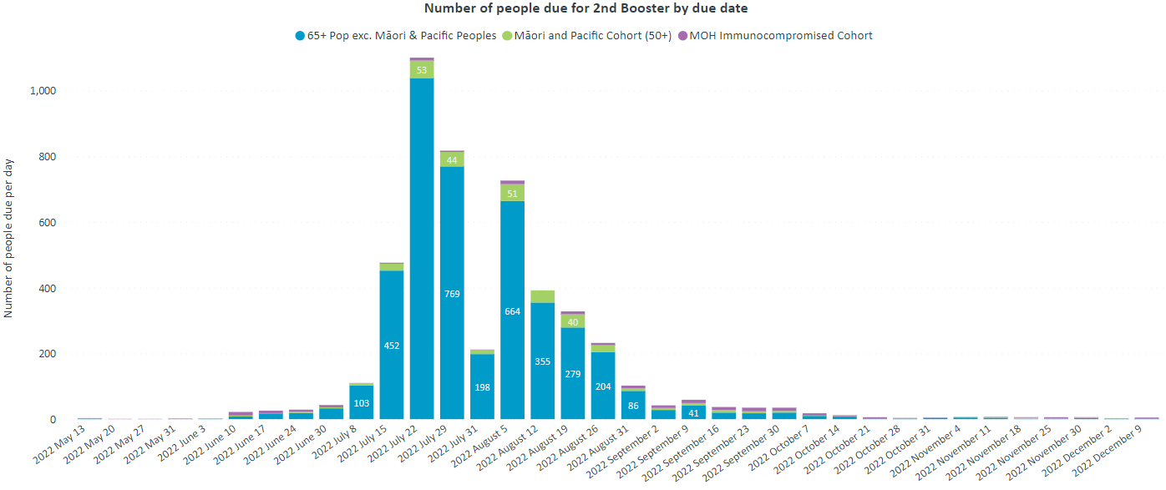
Second booster – original Waitaki forecast
Notes:
The MoH has yet to announce eligibility criteria for the 2nd booster.
This data shows demand based on an assumption that groups 1 (border workers) and 2 (health worker) may be eligible (green).

