Slide 1
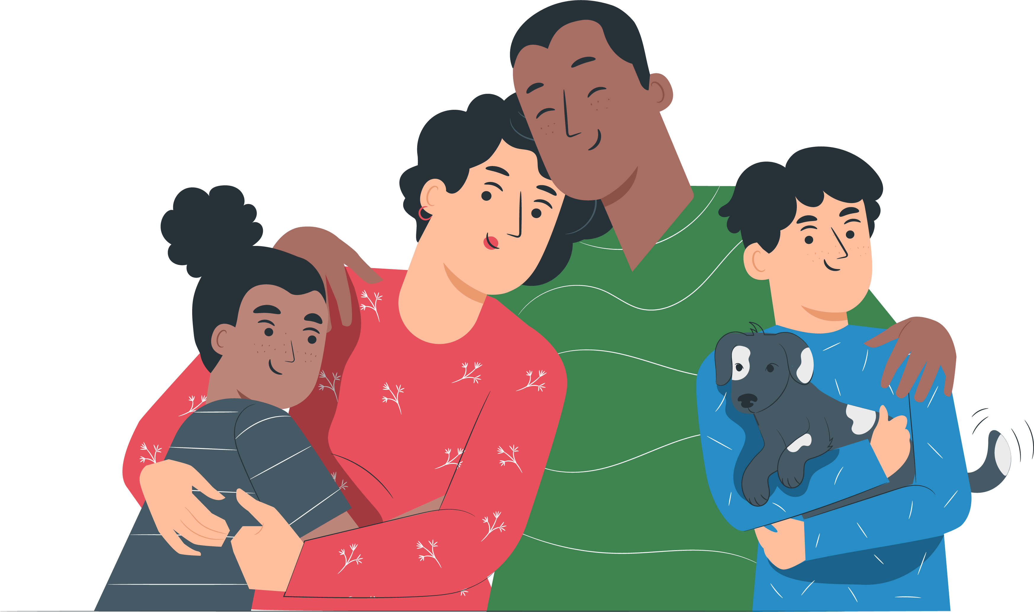
Provider webinar November 2021
All-in-immunisations Provider webinar 9 June 2022

Slide 2
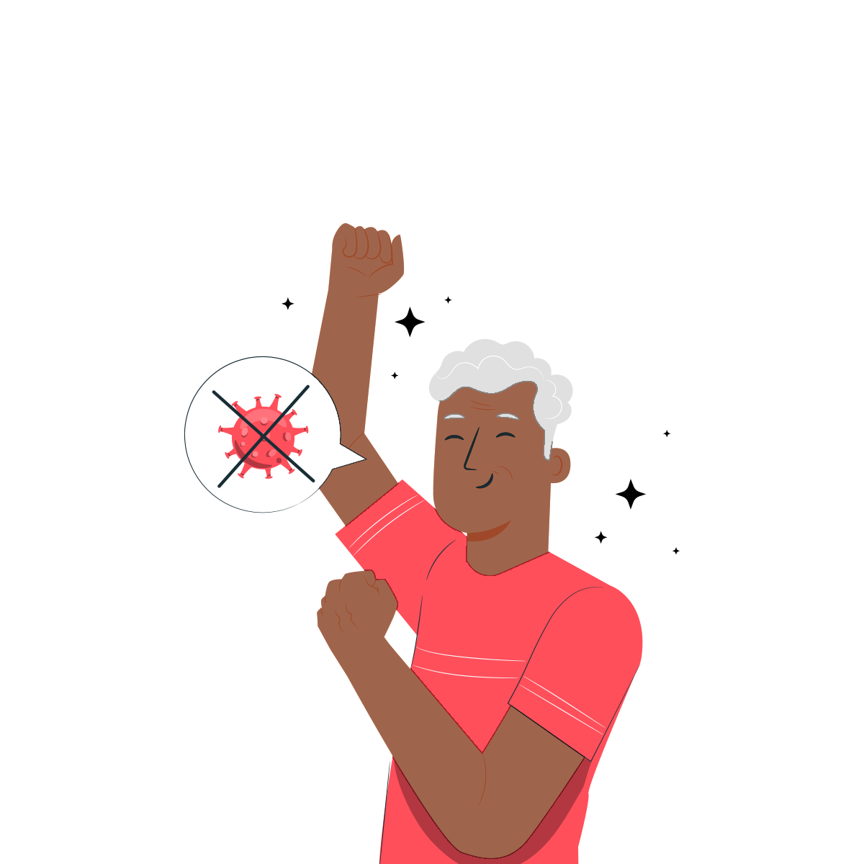
Contents
Welcome
COVID-19 vaccination statistics – local and national
COVID-19 vaccination equity update
COVID-19 second booster
Provider showcase: BAU in a low-demand environment
All-in immunisation – Influenza and MMR
CIR, logistics and cold-chain monitoring
Questions
Reference – COVID-19 second booster demand by TA
Notes:
Karl to present + welcome and introductions

Slide 3
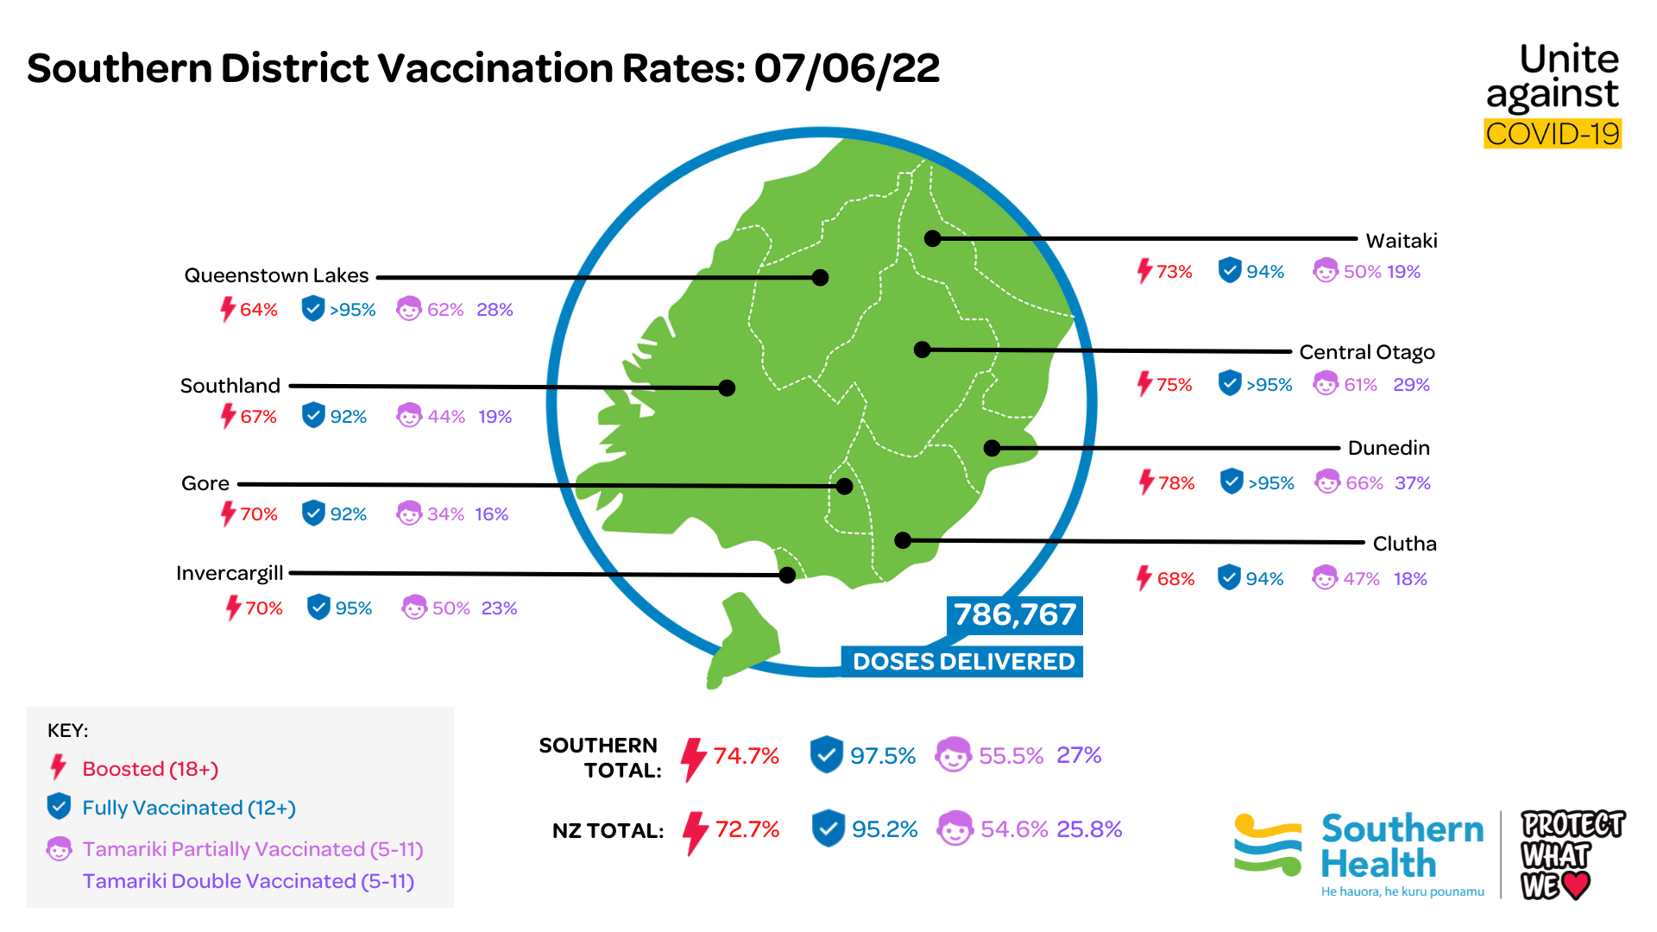
Data: 7 June 2022 Source: MoH
Notes:
Emma to present

Slide 4
COVID-19 vaccination
equity update
Notes:
Nancy to present

Slide 5
Māori: COVID-19 vaccination rates
 | Southern Rates | National Rates
Single dose (12+) | 94.9% | 91.3%
Double dose (12+) | 92.6% | 88.4%
Booster dose (18+) | 60.2% | 55.8%
Paediatric first dose (5-11) | 41.2% | 35.5%
Paediatric second dose (5-11) | 17.2% | 12.4%
Data: 7 June 2022 Source: MoH
Notes:
Nancy to present

Slide 6
Pasifika: COVID-19 vaccination rates
 | Southern Rates | National Rates
Single dose (12+) | >99% | 98.4%
Double dose (12+) | >99% | 96.7%
Booster dose (18+) | 60.2% | 59.3%
Paediatric first dose (5-11) | 54.9% | 48%
Paediatric second dose (5-11) | 18% | 15.4%
Data: 7 June 2022 Source: MoH
Notes:
Nancy to present

Slide 7
Targeted call campaign – First booster
The Southern Covax team is currently calling approximately 4200 vulnerable people who haven’t had their booster, including:
65 years + excl Māori and Pasifika
50 years + Māori and Pasifika
Immunocompromised
Offering people support to get their booster with a local provider – including:
Booking on BMV
Local walk-in options
Call back by a registered nurse
Home visit
We have called 70% of this group so far, and of these people, we have spoken to nearly half. We will be able to share results at the end of the campaign.
Notes:
Emma to present

Slide 8
COVID-19 second booster
Six month interval from first booster
Proposed eligibility includes
People aged 65+
Māori and Pacific peoples aged 50+
Residents of aged care and disability care facilities
Severely immunocompromised people
New legislation expected to be in effect from end-June.
In the meantime, if clinical circumstances warrant, people can access a 2nd booster ‘off-label’ provided consent is obtained, and an authorised prescriber is willing to prescribe it.
Notes:
Emma to present

Slide 9
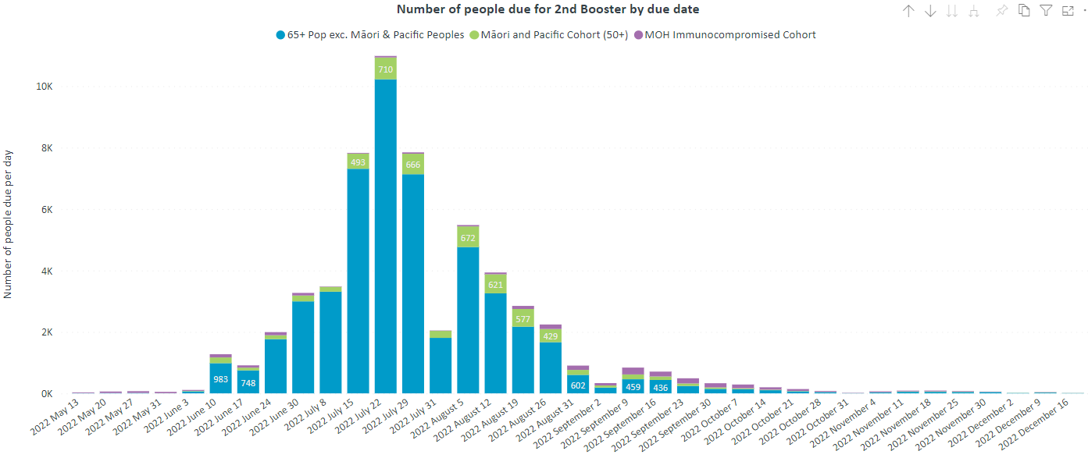
COVID-19 second booster eligibility
Notes:
A TA breakdown is available at the end of this presentation.
Demand is based on people who received their booster six months ago. People who have not received a first booster are not represented in this forecast demand

Slide 10
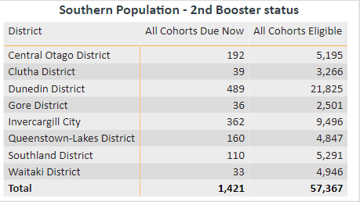
COVID-19 second booster eligibility
– by TA
Covid infection rates will flatten 2nd booster demand, it is difficult to predict this accurately due to under-reporting of infections
Notes:
MoH has yet to announce eligibility criteria for the 2nd booster. This data shows potential demand if cohorts are eligible.

Slide 11
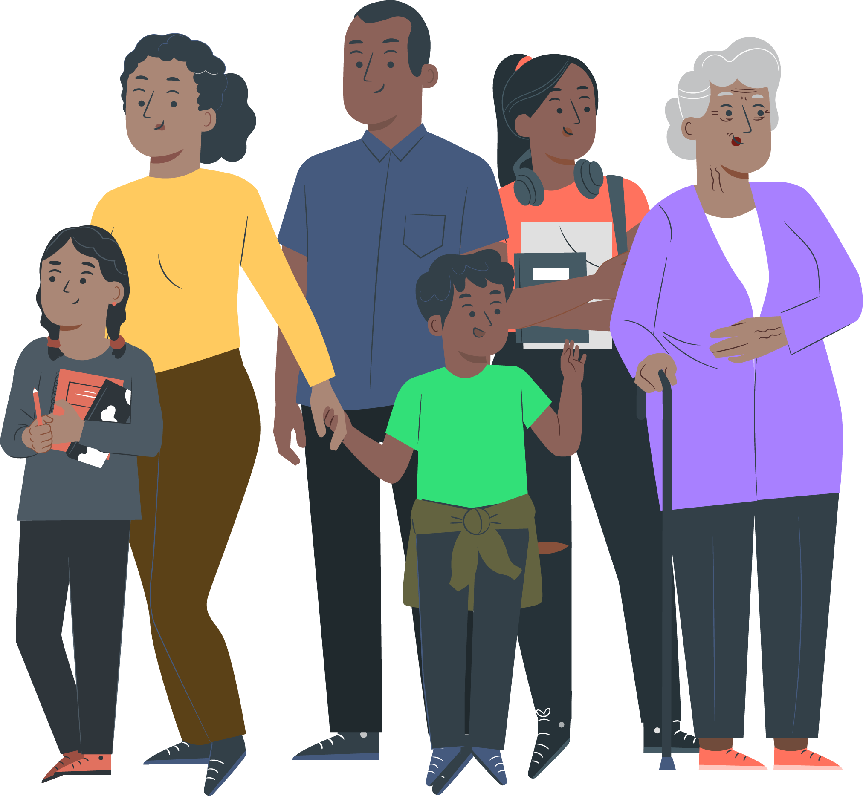
What are other providers doing?
Notes:
Emma to present

Slide 12
All-in imms
COVID-19 is still circulating widely in the community, and the re-opening of our borders may bring more Influenza and infectious diseases.
In March, the MoH asked COVID-19 vaccination programmes nationally to shift to an "all-in immunisation" approach.
In response, the Southern COVID-19 vaccination programme is working with other parts of the health system to form a joined-up ‘all-in-imms’ response
The mass vaccination centres in Southern now offer flu and MMR vaccinations to support primary care in the peaks of demand with surge capacity, outreach and home visit services.
Notes:
Emma to present

Slide 13
All-in imms
The Vax Hub has been extended to include updates and information on Flu and MMR.
MoH has launched a Winter Wellness brand to ensure a co-ordinated approach to communications pre-winter, winter and post winter. This includes a unifying logo (lock-up) which is available from their resources dropbox. They are also working on a message bank.
You can now order flu collateral through Romilly Smith and will soon be able to order MMR collateral too.
Notes:
Emma to present

Slide 14
Influenza
After 2 years of pandemic measures our community immunity is lower than normal and with international borders opening, we’ll see new strains of flu spreading in our communities
Current Influenza A outbreak in Dunedin, expectation this will impact a wider area and older age bands
Notes:
Paul R to present

Slide 15
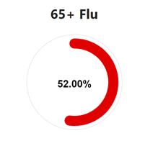
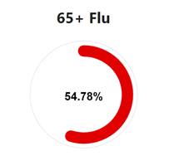
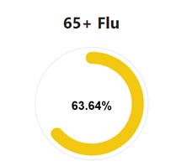
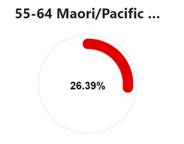
Influenza data by age
Pasifika
Māori
All ethnicities
Enrolled population data 8 June.
The MoH will begin publishing flu vaccination rates on their website. This is expected to go live on 9 June.
Notes:
Emma to present

Slide 16
MMR
Measles outbreaks happen regularly overseas, and with people coming into Aotearoa New Zealand, there’s a risk of measles spreading here.
New Zealand’s measles vaccination rates have fallen in the past few years, and we need to boost them again as we reopen to the world after COVID-19.
Notes:
Emma to present

Slide 17
MMR
30 pharmacies are now onboarded districtwide
NZME Advertising Campaign (25th May – 20th July) – radio and social media advertising campaign targeting Māori and Pasifika in the Southern region
Working with community organisations
Reaching out to the business community in Queenstown who may be looking to recruit migrant workers
Notes:
Emma to present

Slide 18
CIR – COVID-19
In preparation for 2nd boosters, if staff have not logged in for 60 days, please request your access be requalified and reinstated – email shelby.davidson@southerndhb.govt.nz
Boosters must be entered as their own case. Don't enter as a third primary dose
Scripts must be uploaded for any ‘off-label’ use (eg 3rd primary doses for immunocompromised, early second boosters)
Backlog of incorrect data entry and missing consent form/script uploads
We may be in touch to resolve historical issues.
Primary concern -scripts that have not been uploaded (required by law).
Notes:
Andrew to present

Slide 19
Incorrect vaccination incidents – COVID-19
For incorrect vaccination incidents:
Enter all dose errors into the patient’s CIR record
Complete the MoH form as outlined in the toolkit, and
Notify your SDHB or WellSouth Lead including sending them a copy of the Serious incident/adverse event notification form so we are aware of the error and can offer support
Find a range of 'How-To's on the CIR homepage or contact romilly.smith@southerndhb.govt.nz with any issues.
Notes:
Andrew to present

Slide 20
Ordering vaccine
Phased approach to all providers ordering their own vaccine
If you have not yet been introduced to this process, you will be contacted this/next week with information on using the ordering portal and things to think about when managing and ordering vaccine
SDHB will continue to oversee orders to offer advice and support where needed
If you have any questions or issues, please contact nicole.gorman@southerndhb.govt.nz
Notes:
Andrew to present

Slide 21
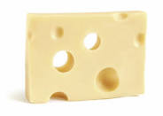
Review your cold-chain monitoring
If something goes wrong, will your records be good enough to avoid a cold-chain failure?
Recent 'near-miss’
Vaccine fridge lost power
Gap in daily max-min records (responsible person absent)
Datalogger was overwriting previous data
Staff changes clouded responsibility for datalogger monitoring
Notes:
Andrew to present

Slide 22
Review your cold-chain monitoring
“National Standards for Vaccine Storage and Transportation for Immunisation Providers 2017”
Two systems for monitoring temperature:
min and max temperature recordings taken daily and kept for 10 years
temperature datalogging (captured every 10 mins) downloaded and reviewed weekly*. Store for 10 years.
Make sure you have good processes to cover staff absence, changes in roles etc
Consider upgrading to WIFI cloud-based datalogging (real-time SMS/app/email alerts out-of-range and return-to-range)
Your refrigerator(s)
annual servicing
spatial logging at least every three years.
don’t over-stock. Maintain good air-flow throughout the fridge.
store only medicines and vaccines (no cheese… . )
Notes:
Andrew to present

Slide 23
Questions?
Notes:
Emma to present, team to feed in

Slide 24
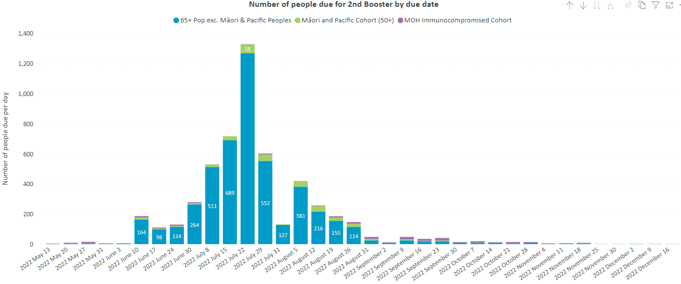
Second booster – Central Otago
Notes:
The MoH has yet to announce eligibility criteria for the 2nd booster.
This data shows demand based on an assumption that groups 1 (border workers) and 2 (health worker) may be eligible (green).

Slide 25
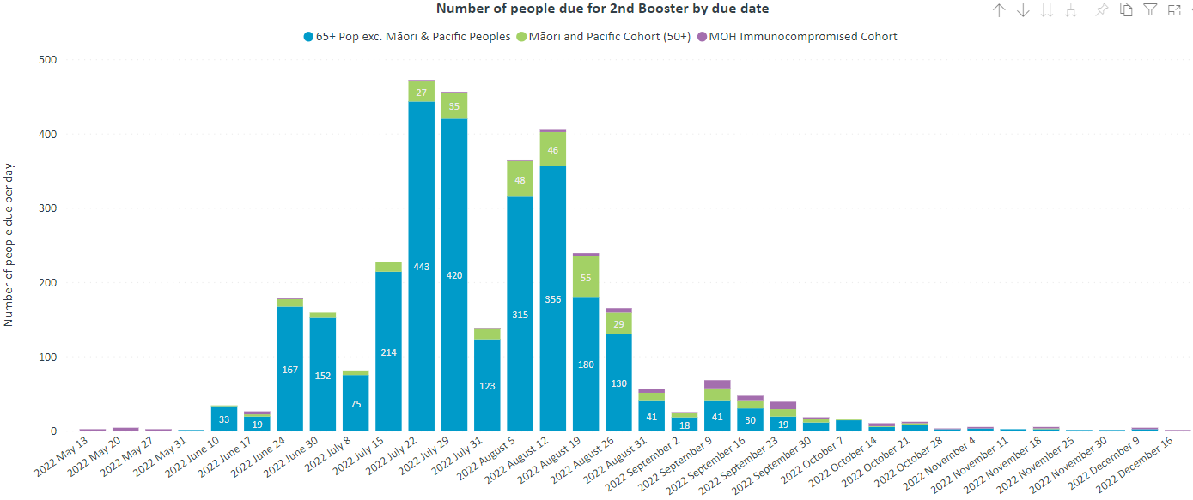
Second booster – Clutha
Notes:
The MoH has yet to announce eligibility criteria for the 2nd booster.
This data shows demand based on an assumption that groups 1 (border workers) and 2 (health worker) may be eligible (green).

Slide 26
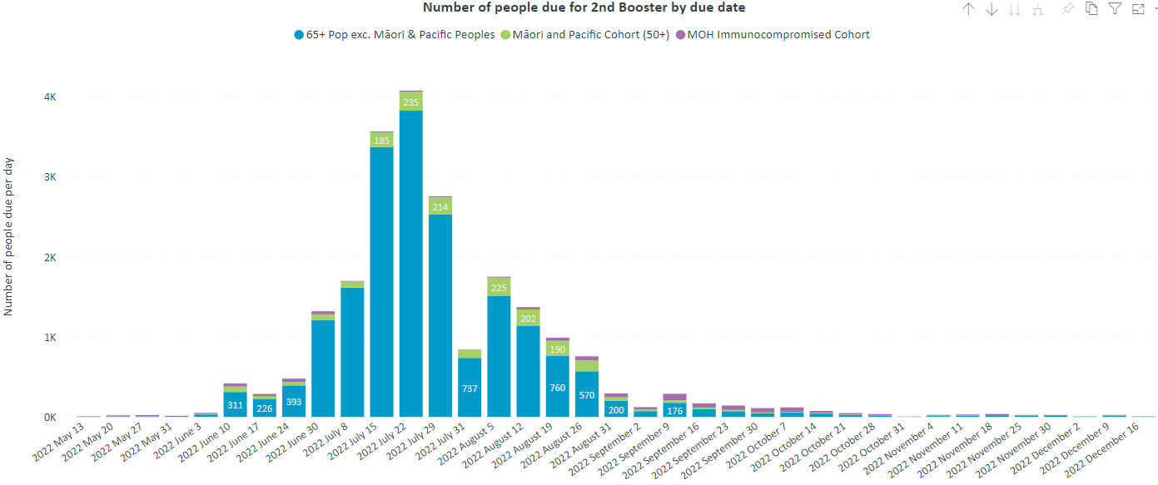
Second booster – Dunedin
Notes:
The MoH has yet to announce eligibility criteria for the 2nd booster.
This data shows demand based on an assumption that groups 1 (border workers) and 2 (health worker) may be eligible (green).

Slide 27
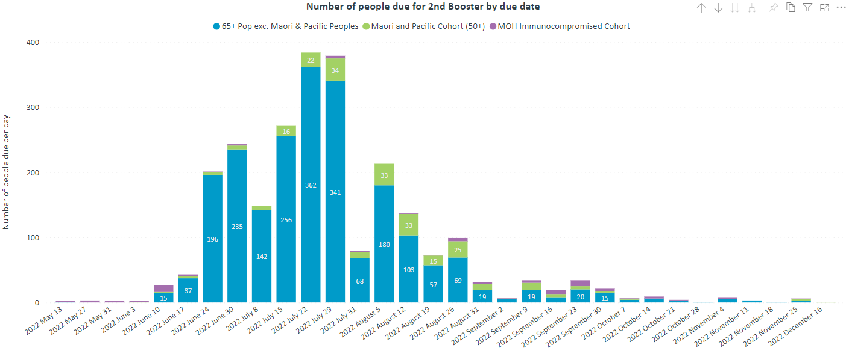
Second booster – Gore
Notes:
The MoH has yet to announce eligibility criteria for the 2nd booster.
This data shows demand based on an assumption that groups 1 (border workers) and 2 (health worker) may be eligible (green).

Slide 28
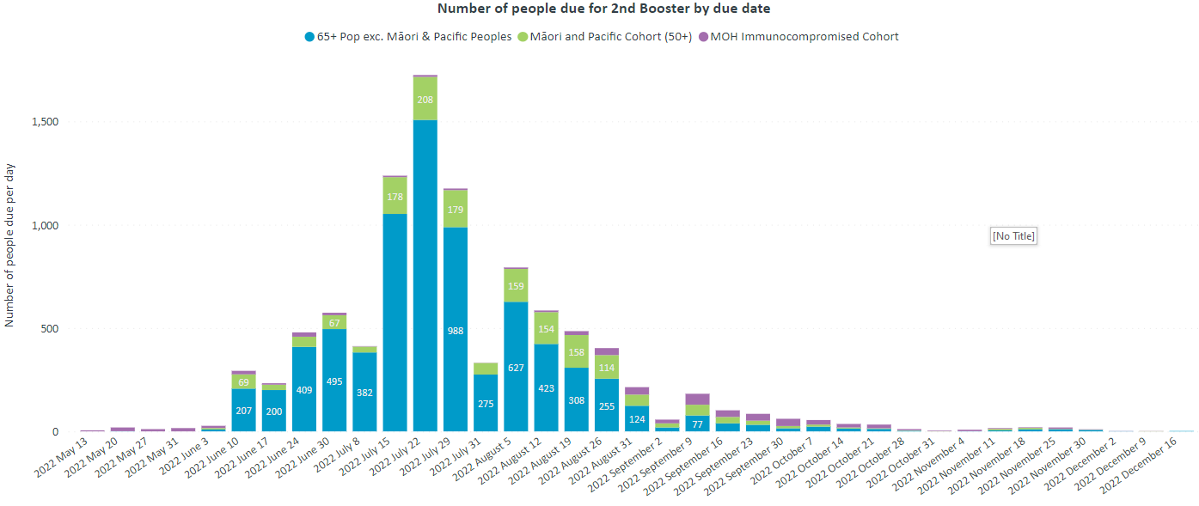
Second booster – Invercargill
Notes:
The MoH has yet to announce eligibility criteria for the 2nd booster.
This data shows demand based on an assumption that groups 1 (border workers) and 2 (health worker) may be eligible (green).

Slide 29
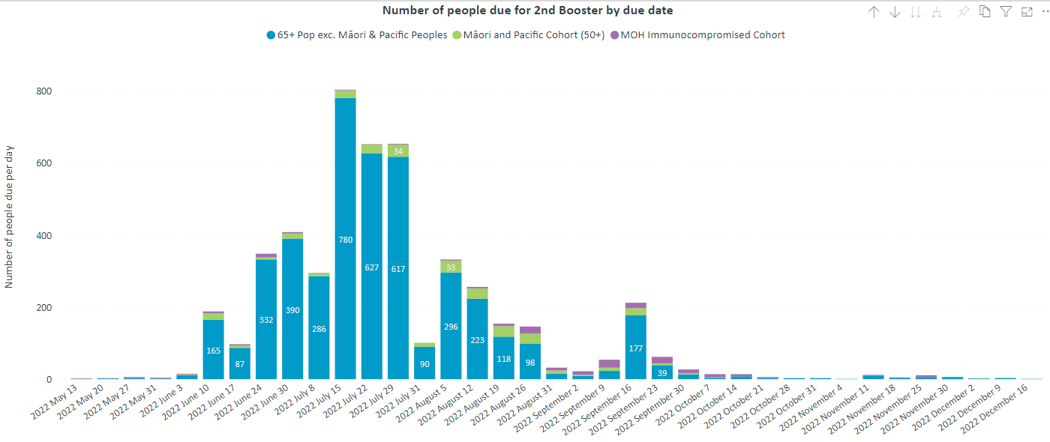
Second booster – Queenstown Lakes
Notes:
The MoH has yet to announce eligibility criteria for the 2nd booster.
This data shows demand based on an assumption that groups 1 (border workers) and 2 (health worker) may be eligible (green).

Slide 30
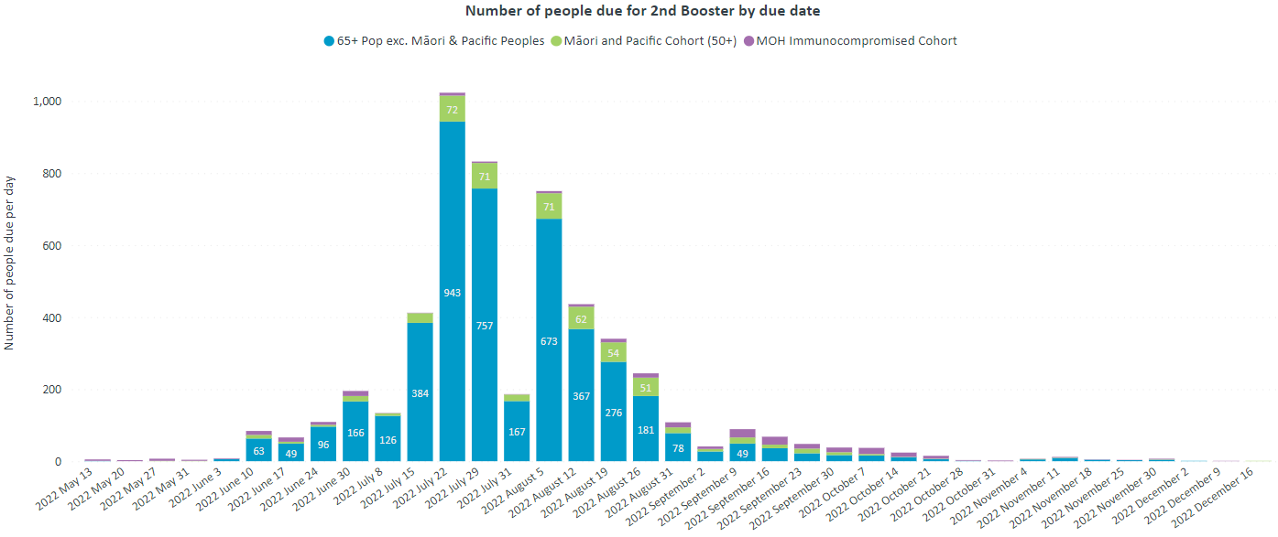
Second booster – Southland
Notes:
The MoH has yet to announce eligibility criteria for the 2nd booster.
This data shows demand based on an assumption that groups 1 (border workers) and 2 (health worker) may be eligible (green).

Slide 31
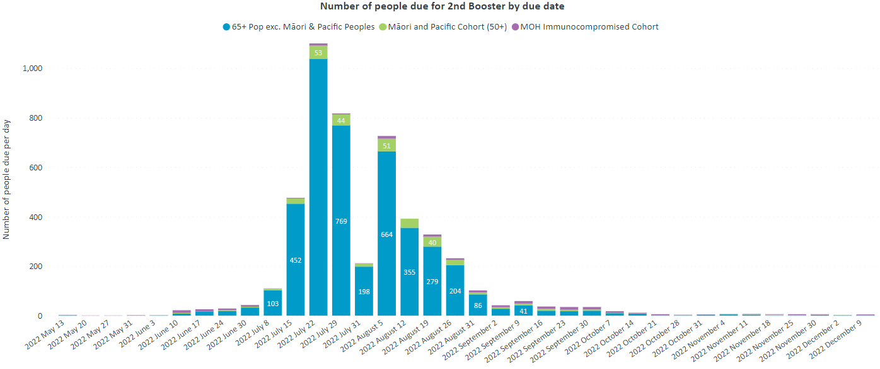
Second booster – Waitaki
Notes:
The MoH has yet to announce eligibility criteria for the 2nd booster.
This data shows demand based on an assumption that groups 1 (border workers) and 2 (health worker) may be eligible (green).

