Slide 1
Public Meeting: Lead and Your Health Wednesday 10th March 2021
Information session for residents of
Waikouaiti, Karitane & Hawksbury Village

Slide 2
Health information provided by:
Public Health South, Southern DHB:
Dr Susan Jack, Medical Officer of Health, Clinical Director
Dr Michael Butchard, Medical Officer of Health
Dr Adam Pomerleau, Director of Poisons Centre, Medical Toxicologist and Emergency Medicine specialist
Dr Gloria Dainty, Paediatrician

Slide 3
Expert Advisory Group
Dr Richard Jaine, Ministry of Health
Dr Andrea ‘t Mannetje, Massey University
Prof Katrina Sharples, University of Otago
Dr Belinda Cridge, ESR
Dr Adam Pomerleau, National Poisons Centre
Analysts
Dr Andy Anglemeyer, ESR
Callum Thirkell, ESR

Slide 4
Blood Lead Levels - Outline
Key findings
Purpose of taking blood lead levels
How many people
Detailed findings
Adults
Children
Comparisons with NZ survey
Changes over time
Conclusions and next steps

Slide 5
Blood Lead Levels – Main Findings
No one had a blood lead level that needed hospitalisation or treatment
Very few blood lead levels were above the new threshold
The blood lead levels are not substantially higher than expected among adults
We can’t tell if blood lead levels in children are slightly higher than expected although almost all were well below the new threshold
There was no evidence of a difference between those who only drank local water compared to those who did not

Slide 6
Blood Lead Levels – Main Findings
Blood lead levels are generally below notifiable levels and in line with national data
Long-term exposure to lead from the water supply seems unlikely
Public Health South is still advising residents to not drink the water while the investigation into the cause of the elevated lead readings is ongoing.

Slide 7
Blood Lead Levels
Purpose
For individuals to know their own blood lead levels and risk factors for lead exposure
To check the blood lead levels of people living in Waikouaiti/Karitane/Hawksbury village to see if they were higher than expected levels
To see if blood lead levels were in any way related to drinking the water from the local supply

Slide 8
Blood Lead Levels
How many people did we test?
1326 from pop-up community clinic
186 from GPs TOTAL 1512
Most people filled in questionnaires
Some children had a finger or heel prick test This is a screening test and if the result was higher than the threshold they had a venous blood sample.

Slide 9
Blood Lead Level Analysis
Who was included in the detailed analysis?
Those with a matching venous blood test + survey
1018 adults and 141 children
TOTAL 1159

Slide 10
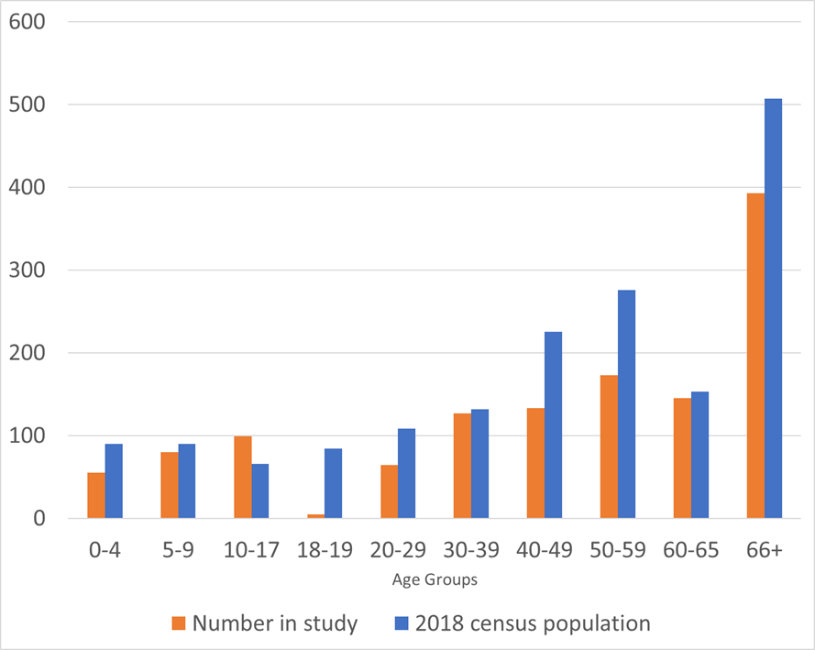
Number tested against estimated population living in Waikouaiti/ Karitane/ Hawksbury Village

Slide 11
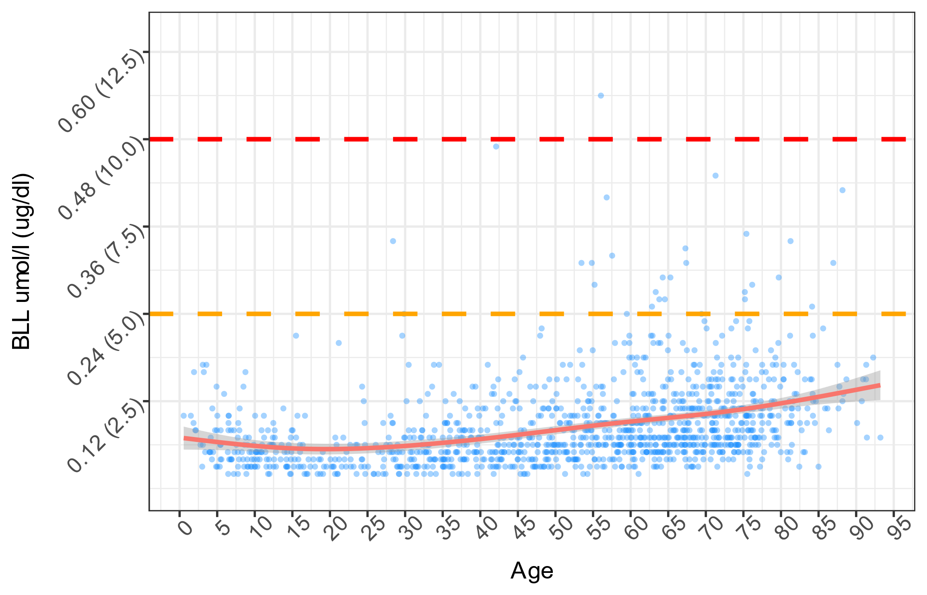
More detailed findings
Most people were well below the new threshold
A small number of people were above the current threshold
Blood lead levels are higher for the older age groups
The patterns seen here are similar to other countries

Slide 12
US Blood Lead Level trends for comparison
https://www-sciencedirect-com.ezproxy.otago.ac.nz/science/article/pii/S0749379721000167

Slide 13
What did we find for children?
This is the first recent survey in NZ that has tested children under 5 years
Children 10-17 years the blood lead levels were similar to the previous national survey
Children 5-9 years the blood lead levels were slightly higher than the previous national survey
Males had higher levels than females

Slide 14
What did we find for children?
Six children had levels above the new threshold on the screening finger/heel prick. All were retested with venous samples and offered a Paediatric assessment
Two children had levels above the new threshold of ≥0.24μmol/L on retesting. One had a strong reason for higher blood lead level (other than drinking the water) and the other we are still investigating. They will be followed and monitored by a paediatrician

Slide 15
What were the factors linked with overall higher blood lead levels in children?
Living in an old house Especially houses built pre-1945
Living in a house with flaky/peeling paint or renovations

Slide 16
What did we find for adults?
Blood lead levels were very similar to the previous national survey
Males had higher levels than females
Blood lead levels are higher in older age groups with higher levels in those aged 65 years+

Slide 17
What did we find for adults?
36 adults had blood lead levels above the new threshold (≥ 0.24μmol/L)
One was above the current threshold (≥ 0.48μmol/L)
Almost all were older than 55 years and had a plausible reason for a higher level.

Slide 18
What were the factors linked with adult higher blood lead levels?
Being male
Eating shellfish
Drinking roof water
Living in or regularly visiting a house with peeling paint or renovations
Risky job
Working with cars
Ship/boat building

Slide 19
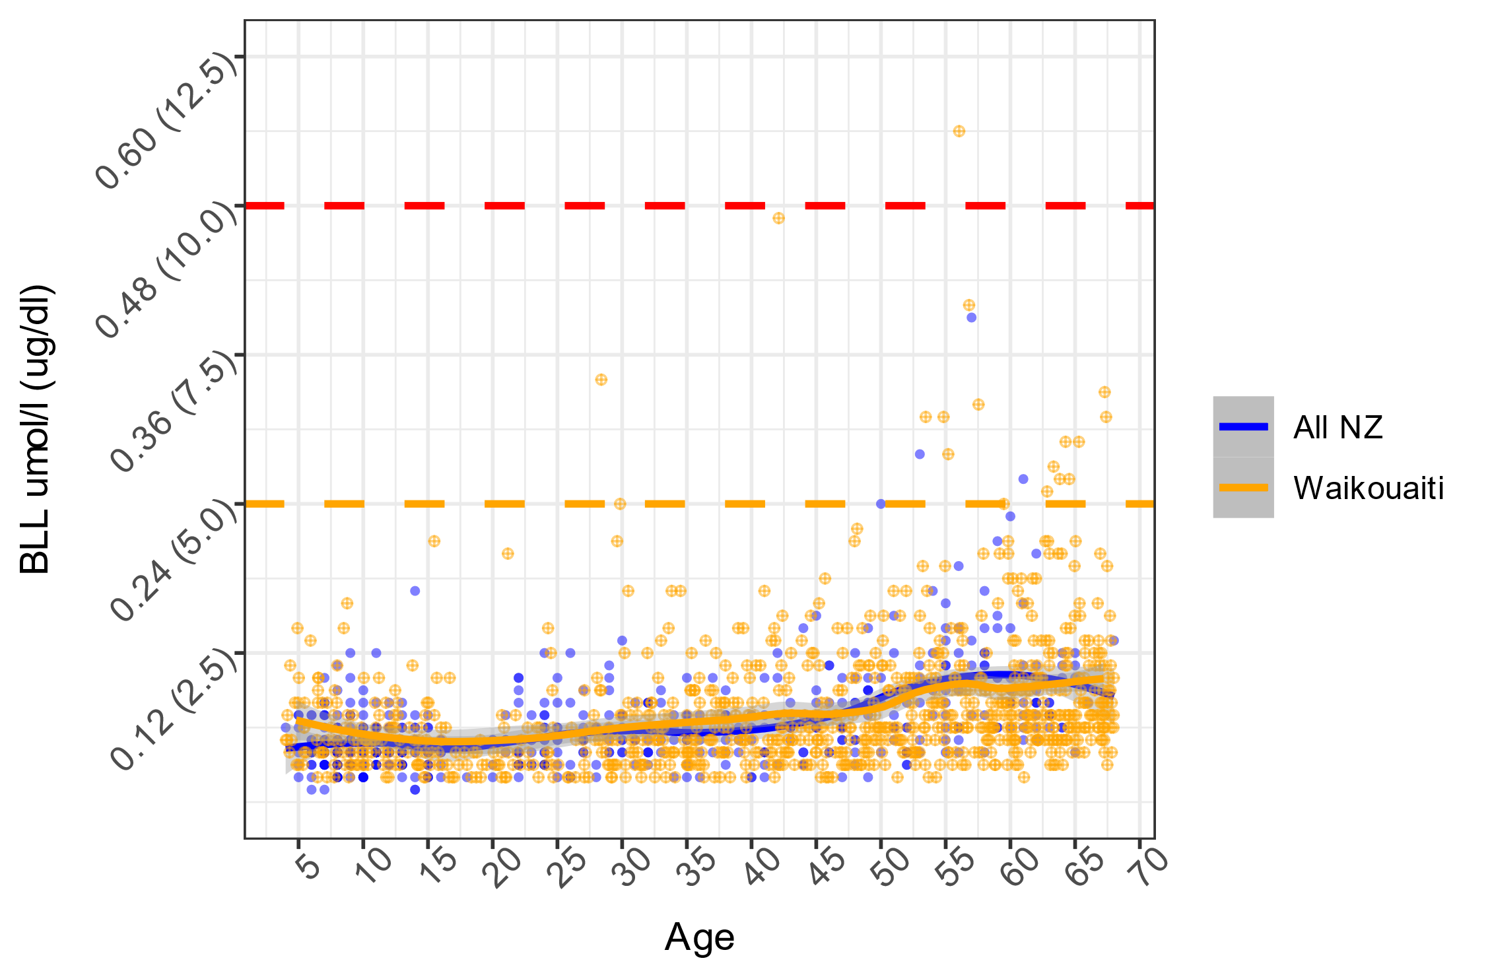
Blood Lead Levels compared to the 2014-2016 NZ survey

Slide 20
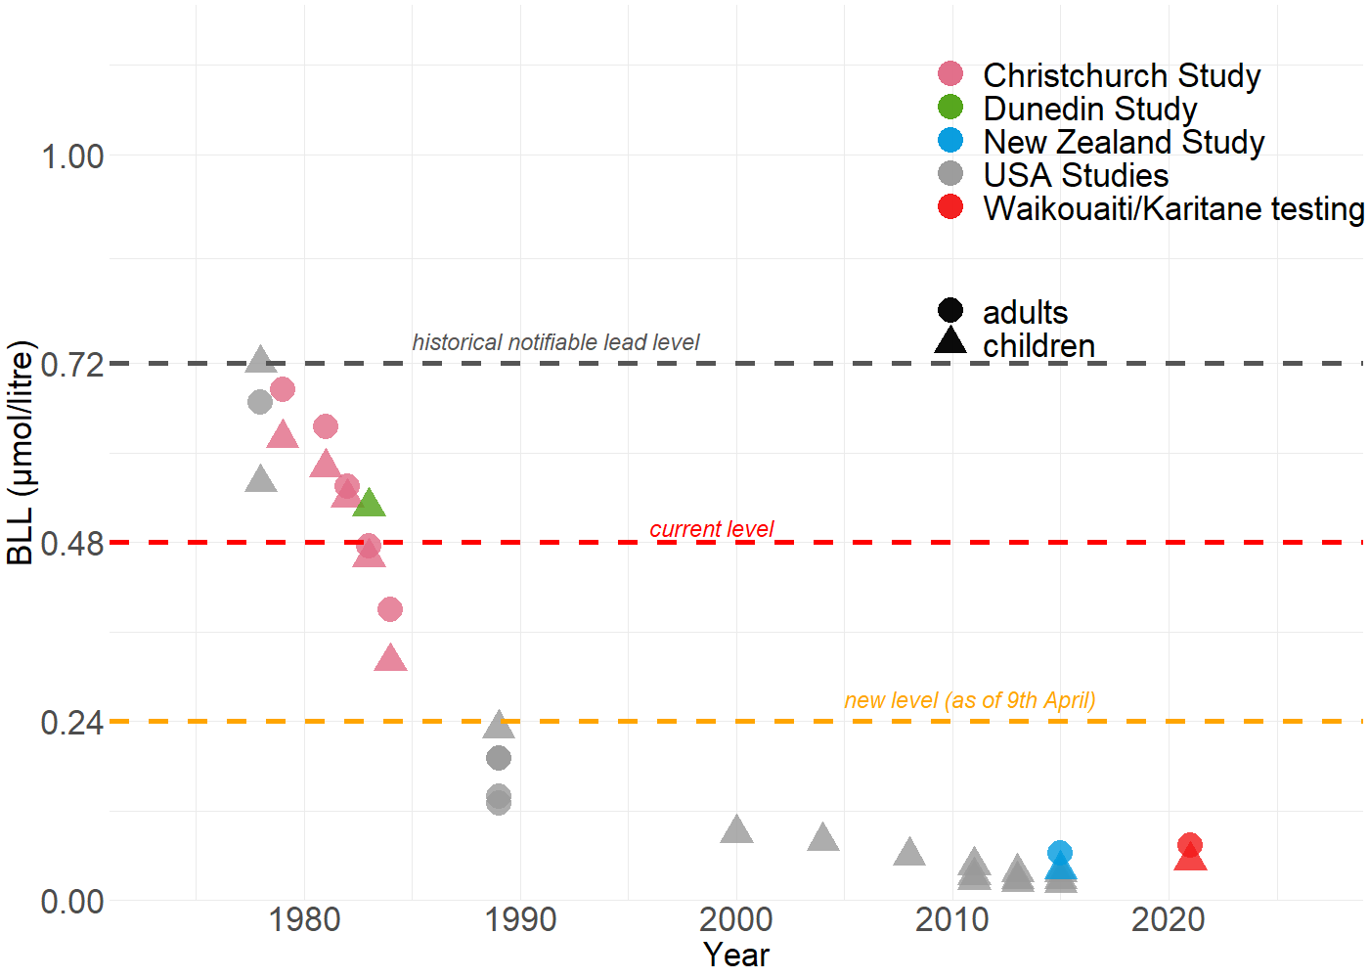
Context: Time trend of blood lead levels & NZ lead mitigation interventions
1975: Introduction of lead-free solder
in baby food cans and
carbonated beverage cans
1979: White lead no longer
used in paint
1983: Content of lead in
all paint further restricted
1986: Start of phase-out of
Lead from gasoline in NZ
1996: Complete phase-out of
Lead from gasoline in NZ

Slide 21
Context: Time trend of blood lead levels & NZ lead mitigation interventions

Slide 22
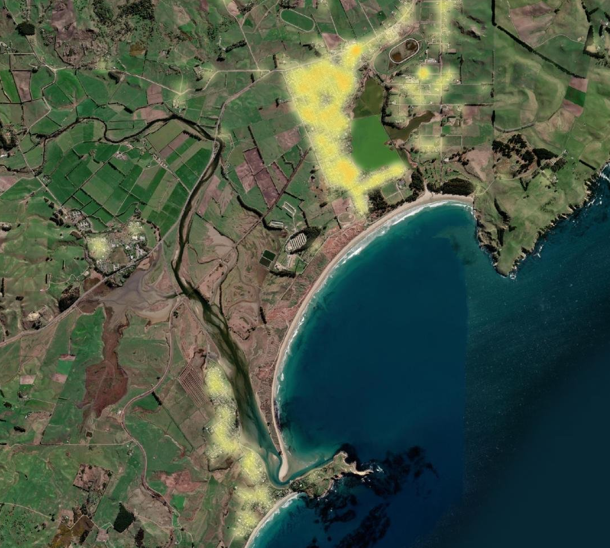
What were the factors NOT linked with higher blood lead levels?
No difference where you lived on the water reticulation system.

Slide 23
How about if you always only drank the local water?
Adults – no evidence of a difference for those who only drank the local supply compared to those who didn’t
Children – no evidence of a difference for those who only drank the local supply compared those who didn’t.

Slide 24
Did the lead spikes in the water have any impact on Blood Lead Levels?
Overall we didn’t find an effect in adults and children over 10 years
We don’t know if there was a very small effect from drinking water in young children
Other lead exposures were much more important

Slide 25
Summary
Some adults and a very small number of children had blood lead levels above the new threshold
The vast majority had blood lead levels below the new threshold
There are many possible reasons for lead exposure
Any health concerns then please do visit your GP for an assessment

Slide 26
What can we do to reduce our lead exposure?
Be careful when renovating old houses
> Stripping paint safely
> Sanding old paint
Fix old houses with chipping and peeling paint
> Vacuum regularly to decrease dust
> Wet-dust floors, ledges, window sills and other flat surfaces at least once a week.

Slide 27
What can we do to reduce our lead exposure?
Flush your taps every morning
Wash your hands
Discourage children eating dirt
Wash dummies and toys frequently – especially if used outside
Check your roof does not have lead-head nails if you are collecting drinking water

Slide 28
Next steps
Health providers will continue to provide care for individuals and advice around environmental lead exposures
If you are still have some individual health concerns then please do go and see your GP and be fully assessed.
Public Health South will continue to work with Dunedin City Council to ensure the water is completely safe before allowing its use for drinking

